Slide 1
European Access Hurdles Portal:
Summary of the second external report
7th May 2024

Slide 2
The industry created the European Access Hurdles Portal to add new information to the debate on availability of innovative medicines
Created in April 2022, the role of the Portal is to improve transparency regarding the root causes of unavailability and delay, including the role of the environment and its corresponding impact on commercial decision-making
2010 – First report on the Patients W.A.I.T. (Waiting to Access Innovative Therapies) Indicator
2020-2022 – Annual reporting on Patients W.A.I.T. Indicators and root causes of unavailability
April 2022 – Industry commitment to the creation of the European Access Hurdles Portal
April 2023 – Release of the first public report from the Portal
June 2024 – Release of the second public report from the Portal

Slide 3
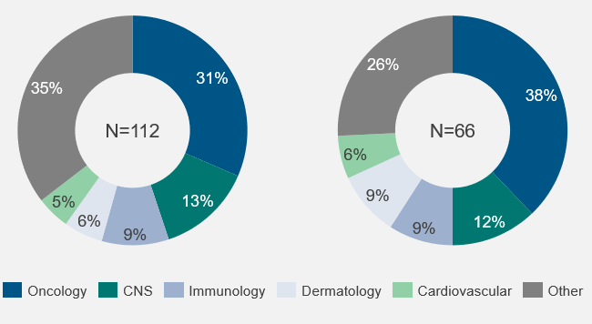
Results indicate a complete willingness from industry to provide more transparency on the root causes of unavailability
Industry participation
Data completeness and representativeness
Data on 66 products were submitted to the Portal.
All received European marketing authorisation between January 2021 and June 2023.
Therapy areas of products approved by the EMA between Jan 2021-Jun 2023
Therapy areas of products included in the Portal dataset between Jan 2021-Jun 2023
66
All 32 EFPIA member companies with eligible products submitted data to the Portal (100% participation)
100%
The analysis described in this report is therefore representative of 100% of all products approved by the EMA between January 2021 and June 2023 that are marketed by EFPIA members
The therapy areas of Portal products and the composition of products approved by the EMA over the same time period are similar – suggesting the products within the Portal are representative of the types of innovative medicines approved by the EMA over this period
100%
Abbreviations: EFPIA = European Federation of Pharmaceutical Industries and Associations; EMA = European Medicines Agency

Slide 4




This report presents an updated analysis focusing on a set of key research questions
Speed of marketing authorisation
Status of filing and reimbursement
Speed of filing and reimbursement
Root causes of delays
How does Europe compare to other regions in terms of the timing of marketing authorisation?
What proportion of new medicines have been filed for P&R, and in how many countries?
To what extent is delayed reimbursement of new medicines due to the time taken at different steps of the P&R process?
Where new medicines have not been filed for P&R in all countries, what are the most prevalent root causes of this?
Of all new products approved by international regulators between January 2021 and June 2023, EMA approval came later, on average, than the US and by Japan by 327 days and 214 days respectively
Looking at the Portal’s products (that are on average 20 months-post MA), taking an average across European countries, more than half of products have been filed for P&R
While there are delays in P&R filing in for some products in some countries, this is not a key driver of low availability of medicines in all countries (accounting for 29% of the total time between MA and reimbursement on average)
The reasons for both delays in P&R filing and P&R decision making are multi-factorial, varying with respect to the region and the size of company filing for P&R
Abbreviations: EMA = European Medicines Agency; MA = marketing authorisation; P&R = pricing and reimbursement

Slide 5
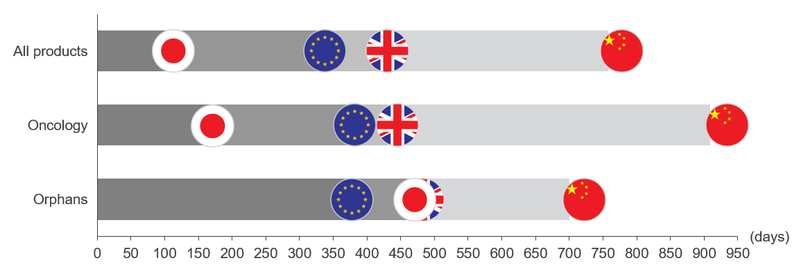
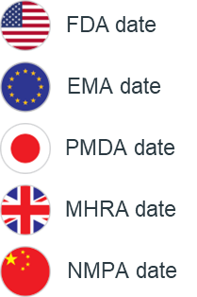
The products in-scope of the Portal received marketing authorisation later in Europe than in the US and Japan
Speed of marketing authorisation
Status of filing and reimbursement
Speed of filing and reimbursement
Root causes of delays
Key findings: Speed of marketing authorisation
Of all new products approved by international regulators between January 2021 and June 2022, EMA approval came later, on average, than the US and by Japan by 327 days and 214 days respectively; this is represents an increase since the April 2023 report
For oncology drugs, European marketing authorisation happened, on average, 204 days later than Japan and 373 days behind the US. This represents a worrying trend versus 2023, where EMA approval came 47 days before PMDA
For orphan products, although EMA approval comes 365 days after the US, it comes 94 days before Japan
This shows that even before considering the P&R process, Europe is slower in approving new products than the regulatory agencies in other regions¹
Date of EMA approvals relative to the US, UK, Japan and China
Legend:
No. of dates used to calculate averages ( / 127):
 | FDA to EMA | FDA to PMDA | FDA to NMPA | FDA to MHRA
All products | 109 | 38 | 20 | 86
Oncology | 36 | 7 | 8 | 32
Orphans | 38 | 12 | 7 | 31
1. This lag may also be due – at least in part – to companies taking more time to file for marketing authorisation through the EMA compared to the FDA. Data on submission dates to the FDA and EMA are not publicly available.
Abbreviations: EMA = European Medicines Agency; FDA = Food and Drug Administration; MHRA = Medicines and Healthcare products Regulatory Agency; NMPA = National Medical Products Administration; PMDA = Pharmaceuticals and Medical Devices Agency

Slide 6
In many instances of product unavailability, the products have in fact been filed for reimbursement but have not yet been reimbursed
Speed of marketing authorisation
Status of filing and reimbursement
Speed of filing and reimbursement
Root causes of delays
Key findings: Status of filing and reimbursement
Status of product reimbursement and filing across countries
Looking at all products included in the Portal to date (products that are on average 20 months post-MA):
  Taking an average across European countries, 56% of products have already been filed for P&R. Of which:
    45% of filed products have been reimbursed
    49% of filed products are pending a reimbursement decision
    7% of filed products have had a negative reimbursement outcome
  A further 10% of non-filed products are available through an alternative access pathway
The percentage of products that have been filed for P&R varies significantly based on geography (e.g., CEE vs larger European markets), therapy area (e.g., Oncology, Orphan) and product type (e.g., ATMPs).
0%
12%
11%
15%
17%
14%
0%
18%
23%
20%
20%
23%
12%
26%
29%
29%
27%
41%
36%
39%
39%
11%
20%
53%
50%
48%
50%
44%
11%
56%
56%
58%
61%
59%
42%
33%
24%
21%
76%
58%
35%
14%
48%
24%
23%
12%
47%
38%
32%
41%
15%
14%
29%
79%
23%
23%
17%
62%
17%
29%
21%
26%
14%
48%
47%
52%
32%
20%
11%
44%
39%
42%
42%
38%
33%
21%
30%
32%
35%
32%
12%
29%
24%
23%
29%
27%
23%
20%
20%
20%
15%
15%
21%
Italy
Germany
France
Spain
Netherlands
Belgium
England
Sweden
Norway
Denmark
Austria
Finland
Portugal
Scotland
Ireland
Slovenia
Czechia
Poland
Luxembourg
Bulgaria
Croatia
Romania
Hungary
Slovakia
Estonia
Greece
Latvia
Lithuania
Cyprus
Malta
Not yet filed for P&R (unavailable through any public channel)
Filed for P&R (not-reimbursed)
Abbreviations: P&R = pricing and reimbursement; MA – Marketing Authorisation
Not yet filed for P&R (available through EAP/CAP/Other public channel)
Reimbursed

Slide 7
While there are delays in P&R filing in for some products, this is not a key driver of low availability of medicines in all countries
Speed of marketing authorisation
Status of filing and reimbursement
Speed of filing and reimbursement
Root causes of delays
Key findings: Speed of filing and reimbursement
Time to file for P&R as proportion of the total time until reimbursement following EMA marketing authorisation
Although the Portal contains products that have been on the market for different lengths of time, across products that have been successfully reimbursed:
  29% (or an average of 127 days) of the total time between EMA approval and availability can be attributed to the time between receiving EMA marketing authorization and P&R filing
  71% (or an average of 307 days) of this time is attributable to the time between P&R filing and P&R decisions at the country-level
This pattern varies across countries: the proportion of the total time taken up by the time it takes a company to file for P&R is lowest in EU4+UK markets (25% on average) and highest in CEE (30% on average)
773
649
558
591
520
522
551
Total days since EMA marketing authorisation
451
485
485
583
392
392
403
423
427
428
351
349
360
364
380
383
385
291
334
338
317
322
340
563
242
285
288
256
290
275
399
420
206
279
292
290
310
245
314
309
224
216
253
292
148
211
259
171
176
229
182
217
220
240
190
106
154
101
147
114
138
Austria
England
Portugal
Germany
Finland
Sweden
Scotland
France
Denmark
Luxembourg
Belgium
Latvia
Estonia
Netherlands
Ireland
Slovakia
Czechia
Slovenia
Spain
Italy
Greece
Norway
Croatia
Bulgaria
Poland
Romania
Lithuania
180 day transparency directive*
Time to reimbursement decision
Time to P&R filing
Note: Data is not available for all products in all countries. Where the sample size of products in any given country was less than three, these countries have been removed from the figure and include Cyprus, Malta and Hungary. This is due to the risk of bias in the results from a very small number of products and due to the risk of de-anonymizing individual products. The data reported for Germany should be interpreted as time to completion of the national P&R process rather than time to reimbursement, as authorised products are immediately eligible for reimbursement in Germany.
*The time to the reimbursement decision does not distinguish between time taken for stop-clocks, negotiations with manufacturers and active decision-making by the national HTA body

Slide 8
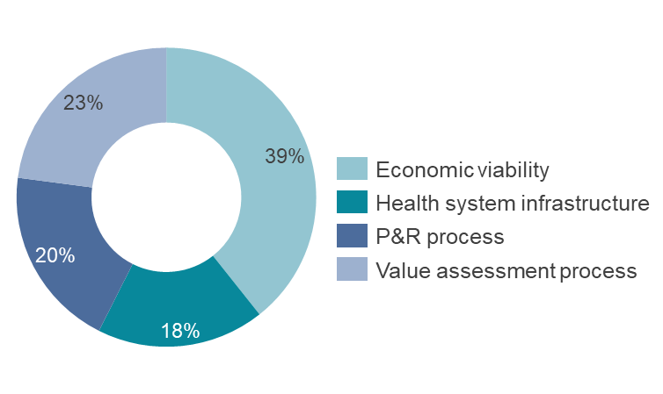
As set out in the root causes analysis, the reasons for both delays in P&R filing and P&R decision making are multi-factorial
Speed of marketing authorisation
Status of filing and reimbursement
Speed of filing and reimbursement
Root causes of delays
Key findings: Reasons for not filing for P&R
Categorization of root causes
Root causes for non-filing have been grouped according to the stage of the P&R process and the stakeholders involved
There is an even spread across the different categories of root causes, reflecting the multi-factorial and varied nature of the P&R filing process
The even distribution across different categories of root causes for non-filing underline that improving P&R filing rate is a shared responsibility, that will require a shared solution from all different stakeholders
Health system infrastructure
Economic viability
Lack of required healthcare infrastructure to support utilization
The size of the treatable population
Lack of company presence in the local market
Lack of healthcare funding to support utilization
The cost of launching is not recoverable
P&R process
Value assessment process
Country filing requirements
Evidence package unlikely to meet country requirements
The impact of external reference pricing on other EU countries
Low value attributed to class competitors
Reasons for non-filing for P&R across all data collection cycles*
Note: The ‘Other’ category was selected in 395 instances. These have been omitted from the root-causes analysis since they cannot be assigned to a specific root cause.
Abbreviations: P&R = pricing and reimbursement

Slide 9
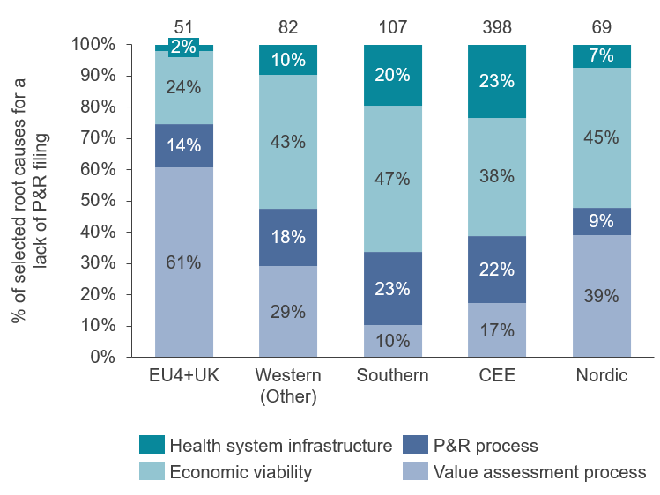
As set out in the root causes analysis, the reasons for both delays in P&R filing and P&R decision making are multi-factorial
Speed of marketing authorisation
Status of filing and reimbursement
Speed of filing and reimbursement
Root causes of delays
Key findings: Reasons for not filing for P&R
Distribution of reasons for non-filing for P&R in all countries, by country grouping*
However, the reasons for non-filing for P&R clearly vary between regions of Europe:
  Delays in filing in Western Europe are largely due to the requirements of the value assessment process
  Delays in filing in Central and Eastern Europe are largely due to health system infrastructure and the corresponding impact this has on commercial decision-making and resource allocation, captured under economic viability
*Country groupings:
EU4+UK: England, France, Germany, Italy, Scotland, Spain
Western (Other): Austria, Belgium, Ireland, Luxembourg, Netherlands, Portugal
Southern: Cyprus, Greece, Malta
CEE: Bulgaria, Croatia, Czechia, Estonia, Hungary, Latvia, Lithuania, Poland, Romania, Slovakia, Slovenia
Nordic: Denmark, Finland, Norway, Sweden
Abbreviations: CEE = Central and Eastern Europe; P&R = pricing and reimbursement

Slide 10
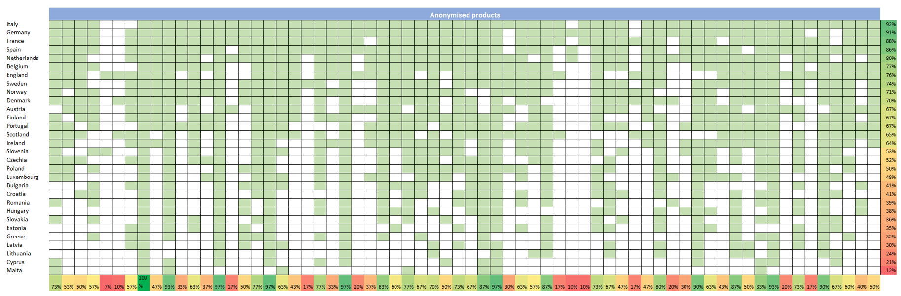
There is significant variation in the reason certain products have not filed for reimbursement in all European countries
Speed of marketing authorisation
Status of filing and reimbursement
Speed of filing and reimbursement
Root causes of delays
Anonymised distribution of product-level P&R filing across countries
This grid shows that there is significant variation across products. This is, in part, due to the length of time since the marketing authorization, but also because of the different types of product included.
The reason for delayed filing varied from product to product. For some groups of products, the impact of external reference pricing was a key driver. In other cases, such as in Greece, ‘country filing requirements’ was listed as the major reason for non-submission.

Slide 11
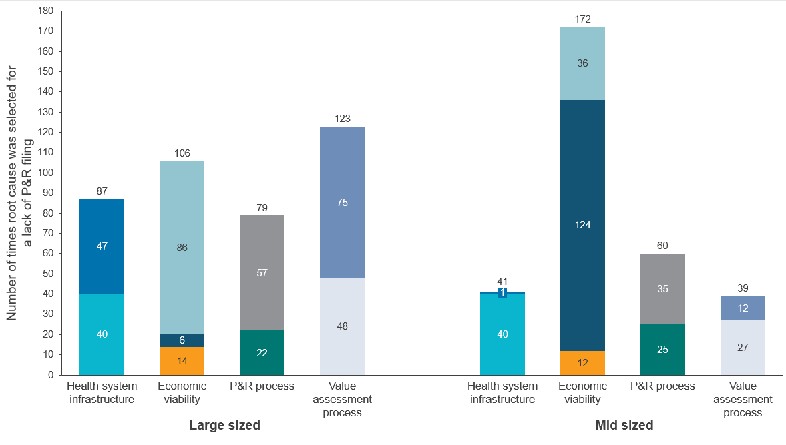
As set out in the root causes analysis, the reasons for both delays in P&R filing and P&R decision making are multi-factorial
Speed of marketing authorisation
Status of filing and reimbursement
Speed of filing and reimbursement
Root causes of delays
Key findings: Reasons for not yet filing for P&R
Total number of reasons for non-filing for P&R by company size*
The reasons for non-filing for P&R also vary between different sized companies:
  Delays in filing for Large companies are fairly well distributed across the root causes
  However, delays in filing in Mid-sized companies relate largely to the economic viability of the decision to launch. More specifically, a ‘Lack of company presence in the local market’ make up the majority of reasons for delay.
The distribution of reasons for non-filing in products that are available through other access pathways are different to the reasons for non-filing for unavailable products
  Reasons relating to economic viability are more common in available products.
*Company definitions:
Large company: Top 20 companies in Europe by European Sales
Medium company: Companies with >€500 million annual European sales, but outside the Top 20
Small company: Companies with <€500 million annual European sales – only 1 small company participated in the Portal, and was grouped with Medium to maintain anonymity.
Abbreviations: CEE = Central and Eastern Europe; P&R = pricing and reimbursement

Slide 12




The Portal provides some initial insights on the factors affecting increasing filing rates
How P&R filing rates change over time are impacted by a number of different factors:
The type of products (e.g., orphan, oncology products)
The length of time since products received marketing authorisation
The overarching environment and situation in individual member states
This highlights the importance of understanding the multifactorial reasons for non-filing when discussing potential mechanisms to improve filing rates
Early indications highlight that some root causes are more easily addressed than others. 13 ‘ceiling’ products were observed in the Portal, where we do not see any increase in P&R filing, irrespective of time since MA.
These products are prevented from filing due to factors such as 'lack of healthcare funding to support utilization' and the ‘evidence package being unlikely to meet country requirements’, which are outside of manufacturers’ control.
Abbreviations: EFPIA = European Federation of Pharmaceutical Industries and Associations; EMA = European Medicines Agency; MA = Marketing Authorisation;
ATMP – Advanced Therapy Medicinal Products; CTF – Commitment to File.

Slide 13
Key conclusions of the second European Access Hurdles Portal report
There is a complete willingness from industry to provide more transparency on the root causes of unavailability, with 100% of eligible EFPIA companies submitting data to the Portal
The data collected in the Portal has matured, enabling more in depth-analysis and the generation of new insights on delays in P&R filing and the lack of availability in some products:
These findings indicate that availability of centrally authorized medicines to patients in European countries is a shared responsibility, requiring a shared solution, necessitating EU-wide, subregion-specific and even country-specific solutions
This is the second report from the Portal; the data collected in the Portal will continue to mature as more cycles of data are collected. This will allow us to further validate some of these early results and to look in more detail at the underlying root causes, as well as any changes to filing rate over time
Speed of marketing authorisation
Status of filing and reimbursement
Speed of filing and reimbursement
Root causes of delays
Even before considering the P&R process, new products received regulatory approval later in Europe than in other regions
In many instances of product unavailability, the products have in fact been filed for reimbursement but have not yet been reimbursed
While there are delays in P&R filing for some products in some countries, this is not a key driver of low availability of medicines in all countries
The reasons for both delays in P&R filing and P&R decision-making are multi-factorial, varying across regions and company size

