Slide 1
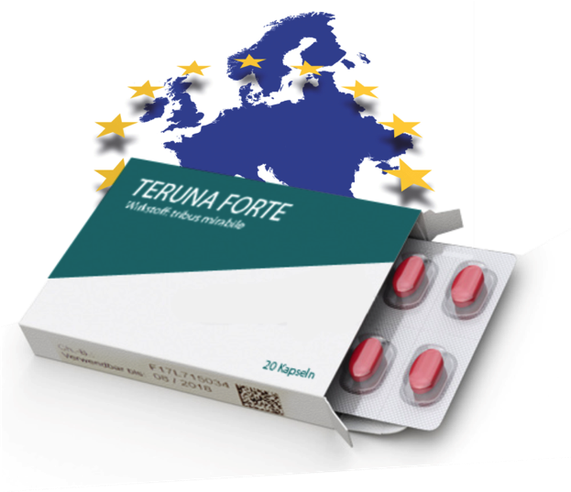





Identification and authentication of medicines in Europe: Opportunities and challenges to comply with EU legislation
2017 China/EU Pharmaceutical Industry Forum
May 17, 2017 Shanghai, China
By Mart Levo
REKS Estonia
Mart.Levo@reks.ee
Notes:
The European Medicines Verification Organisation (EMVO) has taken responsibility for advancing the formation of the European Medicines Verifications System (EMVS) in accordance with the EU´s Falsified Medicines Directive (FMD) and Delegated Regulation (DR). In order to achieve the of a functioning, secure, interoperable and cost effective system across Europe, the EMVO pushes for minimum requirements that meet the FMD and the DR for the establishment of a repositories system, i.e. a European Hub with national or supranational verification systems.

Slide 2
Introduction: EU-FMD background
Safety Features – Impact on Stakeholders
EMVO, EMVS and NMVOs
Conclusions

Slide 3
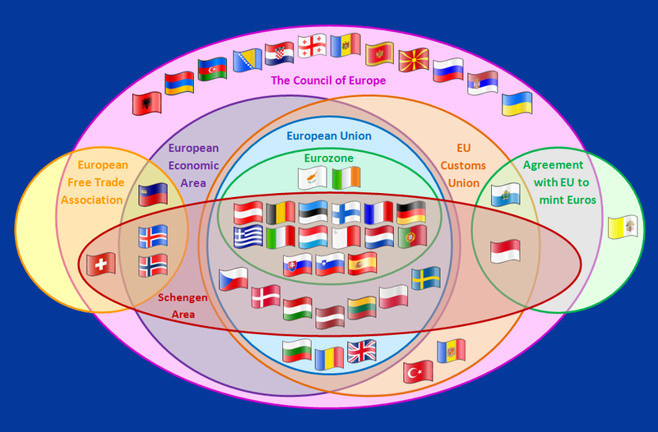
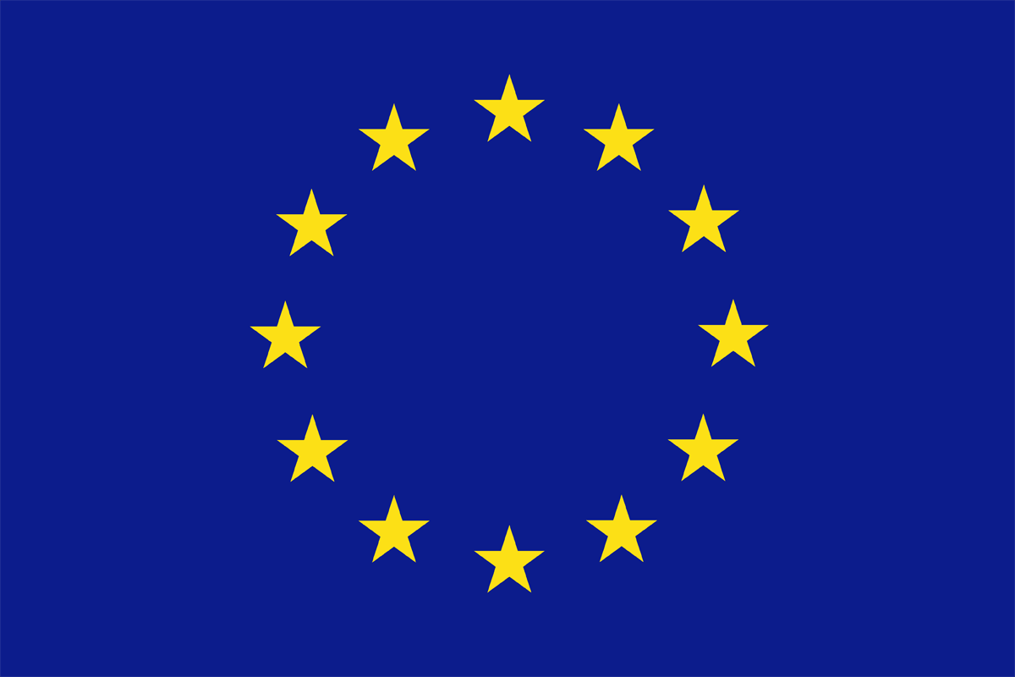
The EU-FMD is
good news:
1 common law
rather than 32
different laws
San Marino
Vatican
Monaco
Notes:
[One Click Build with zoom animation]: Key message is "the EU-FMD is good news: 1 common law instead of potentially 32 different requirements]
The EU-FMD has eliminated the nightmare scenario: 28 different national requirements in Europe: A mix of solutions based on Vignettes, Reimbursement stickers, Security Labels that have to be purchased from the National Mint, national codes carried in different carriers, linear, 2-Dimensional, RFID tags…
Instead there is one set of requirements covering the whole of the EU and, in fact, also being adopted beyond, by Switzerland and Norway, for example who are possibly moving faster than some of the member states…
***

Slide 4
Countries in scope of the the FMD
Notes:
Yellow: 28 EU Member States (MS)
Orange: 3 EEA MS (Iceland, Norway, Liechtenstein)
Salmon: Switzerland
= 32 Countries in scope.
***

Slide 5
EU-FMD Timeline
2011
2012
2013
2014
2015
2016
2017
2018
2019
2020
2025
Compliance for MS w. pre-existing measures
Publication has set the tight 3-year implementation clock ticking for EU-FMD compliance: every pharma company supplying prescription drugs into the European Market will need to be fully EU-FMD compliant by early 2019
Compliance for MS without pre-existing measures
✓ Adoption / ✓Publication of Safety Features DA
✓ Transposition into National Law
✓ Publication of Directive in EU Official Journal
Notes:
[Timeline building up on clicks]
“MS (Member States with pre-existing measures” who benefit from the additional 6 years, to give them the 2025 deadline are:
Italy, Belgium and Greece. But Belgium have indicated that they will follow the 2019 deadline.
***

Slide 6
Key elements of the EU-FMD
1) Unique Identifier | Fully harmonised across the EU: 2D barcode containing 4 mandatory elements – 1) product code, 2) serialisation number, 3) batch number and 4) expiry date and – optionally – as a 5th element the national reimbursement number (if requested by Member States)
2) Tamper-Evidence | Medicinal Products must be tamper-evidenced (EN standard EN 16679:2014 recommended)
3) Repackagers | Parallel distributors to replace safety features with equivalent features = UI de/re-commission
4) Scope | All prescription medicines (unless white-listed), no OTC medicines (unless blacklisted)
5) Process | Systematical end-to-end verification (“before being dispensed to patients e.g. at pharmacy level”) supplemented by risk-based verifications by wholesale distributors: “Medicines at higher risk of falsification (returns or medicines not being distributed directly by manufacturers or marketing authorisation holders or wholesalers distributing on their behalf)”
6) Timing | Compliance across all 28 MS (+ 3 EEA) on Publication of DA + 3 years (or + 9 years for BE, GR, IT)
7) Establishment and Operation of the Repository Systems | The repository containing the unique identifiers should be set up and managed by stakeholders (stakeholder model) with access and a supervisory role granted to National competent authorities
8) Funding | Manufacturers bear the cost of the repository systems
Notes:
[Key elements, revealed on clicks]
Directive 2011/62/EC modifying Directive 2001/83/EC and DR 2016/161
Cost: The challenge is how to square the requirements in the legislation with the practical issue of achieving a fair and manageable way of administering the system costs.
Linked to that is the agreed approach that the upload of the data to the system will be restricted - for security and performance issues - to one “Manufacturer” = “brand owners” which uploads all the data for its. subsidiaries and CMOs rather than multiple sites or organisational units across many member states.
In this context some “manufacturers” = the CMOs should not be required to fund the system but their customers, the brand owners - who hold the Market Authorisations - will be.
Key messages, summarised, are:
The FMD states that the costs of the repositories system shall be borne by the manufacturing authorisation holders (MFR).
The main stakeholders representing manufactures (who are very often also the holders of the marketing authorisations) EFPIA, EGA and EAEPC have agreed upon a model how manufacturers shall pay for the repository systems that is seen to be a transparent, fair, non-discriminatory approach to sharing the cost, proportionate in relation to the services received; this is the flat fee model per marketing authorisation holder (MAH)
Where MFR and MAH are the same, this is clearly unproblematic.
However, if the MFR and the MAH are not one and the same legal entity, the MAH will be required to pay the flat fee for the use of the system; it is expected that the parties would then agree that the cost can be passed on to the relevant MFR who are legally obliged to bear the cost of the system.
***

Slide 7
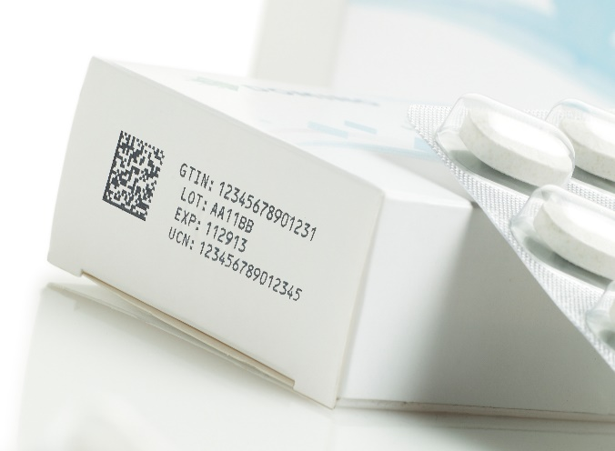

Unique Identifier
Data-Matrix code, developed to ISO-standards
Key data elements:
Product code (GTIN/NTIN)
Batch number
Expiry date
Randomised unique serial number
National health number (where necessary)
Product #: 09876543210982
Batch: A1C2E3G4I5
Expiry: 180500
S/N: 12345AZRQF1234567890
2D DM as data carrier of choice: Compact, Robust, Cost-effective
Notes:
Serialisation – giving each pack a unique identity – is by comparison a strong authentication feature in it’s own right.
It is overt – the serialisation code is visible and can be given semiotic value
It is covert – authentic serial numbers are hidden
It can be authenticated at distance without losing the value of every serial number
It is forensic in the sense that the consumer needs some technology to decode it, however serialisation relies on ubiquitous technology that is already in the hands of consumers telephone networks and the internet
But it’s not a silver bullet and may be used in conjunction with conventional authentication features to give the strongest levels of protection for vulnerable products.
The key message though is that serialisation is the component of the response that has been, and is being identified by an increasing number of markets as fundamental in their efforts to protect patients from the illegal trade in medicines. The regulatory demands for serialisation are growing and the failure to meet these demands will be a barrier to entry to those markets.
The is good news however in that an added bonus of serialisation is that there are wider benefits of the technology that are attractive both to brand owners and consumers and have the potential to offset the cost of implementing serialisation and even generate ROI.
***

Slide 8

Serial Number (EFPIA Pack Coding Guideline)
1) Unique, Random and High Entropy
2) Maximum length 20 chars (alpha-numeric), string should…
only contain either lower case or upper case letters, not a mixture.
exclude the following letters: i, j, l, o, q and u. (I J L O Q U)
= 30 alphanumeric characters available = 20³⁰ possible serial numbers per Product Code
Sparseness = the probability that a valid serial number can be guessed should lower than 1 in 10,000
= 1,073,741,824,000,000,000,000,000,000,000,000,000,000
Notes:
Serial Numbers key requirements are Uniqueness, Randomness and High Entropy.
Taking the guidance published by EFPIA which is based on the GS1-standard, using the maximum length of 20 characters, even excluding a number of characters and other limitations leaves you with plenty of numbers.
***

Slide 9

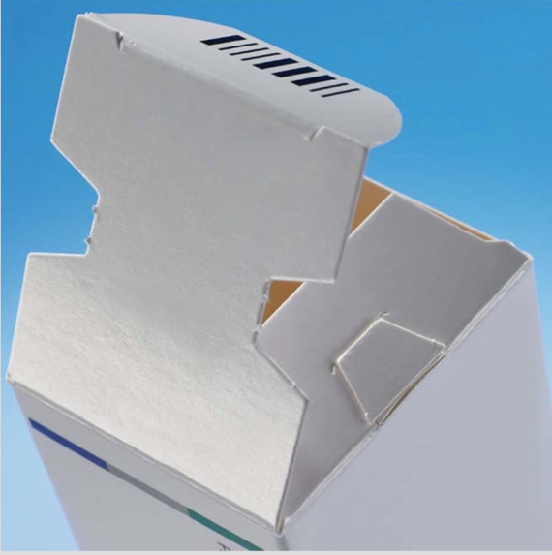
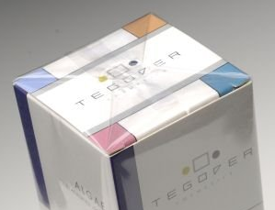

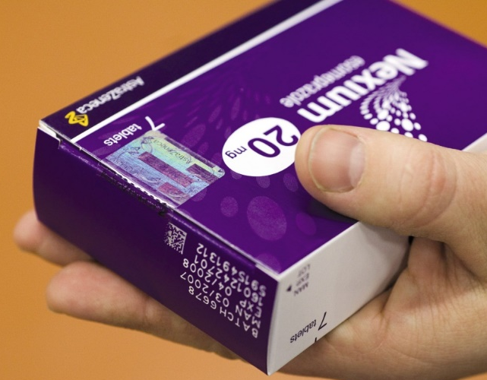
Examples for Anti-Tampering Devices (ATD)
Thanks to Dieter Mößner, Carl Edelmann GmbH
Notes:
Flaps Folding boxes closed with glue: A glue (e. g. hot melt, polyurethane, dispersion or other glues) or a combination of glues is applied to glue and close the flaps of the folding box.
Specially constructed folding boxes: The flaps and the body of the folding box are constructed in such a way that the flaps are inserted by the manufacturer to close the folding box.
Sealing labels and tapes: A label or tape (e.g. from paper, film or laminate) is applied in order to seal the packaging of medicinal products.
Film wrappers: The product container or part of it is wrapped in film ensuring the product is appropriately sealed. The film must be ripped or broken to gain access to the product.
Sleeves: The closure or the complete product container is shrunk in a film ensuring the product is appropriately sealed.
Display blister pack: The product is sealed into a display blister pack which must be cut or broken to gain access to the product.
Breakable or tear-away cap: A breakable or tear-away cap is a plastic or metal cap that has a portion that breaks on opening.

Slide 10
Europe-wide scope of EU-FMD “Safety Features”
Unique Identifier
Tamper Evidence
Safety Features consist of 2 elements: +
All Prescription Medicines (Rx) are in scope….
…apart from those
on the Whitelist
Over the Counter Medicines (OTC) are out of scope…
...apart from those
on the Blacklist
Rx Must carry the safety features
OTC Must Not carry the safety features
Currently white-listed:
Radionuclides
medicinal gases
IV solutions in ATC therapeutic subgroup B05B ‘blood substitutes and perfusion solutions’
contrast media
homeopathic medicinal products
Currently black-listed:
2 strengths of Omeprazol
Notes:
[Slide building on clicks]

Slide 11
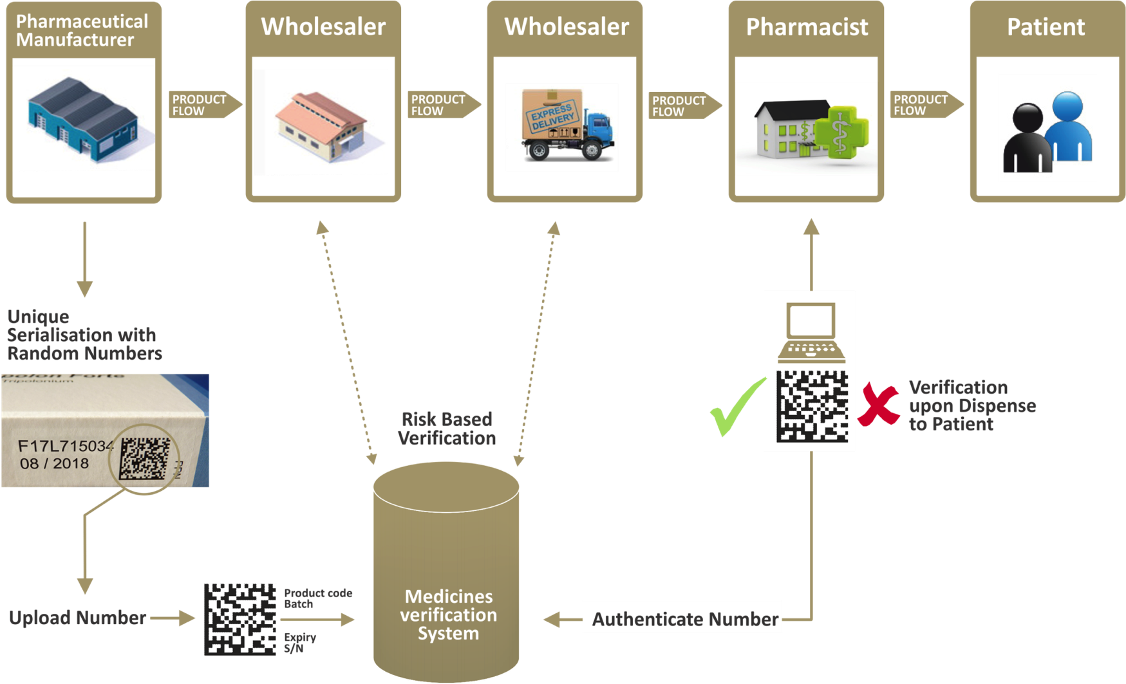
Approach based on the concept: Systematical “Point of dispense verification”

Slide 12

Repositories Systems to carry out the Systematical Point of Dispense Verification
National System
National Blueprint System
National System
National System
National System
National Blueprint System
National Blueprint System
European Hub
Parallel Distributor
Pharmaceutical Manufacturer
National System
National System
Pharmacy
Wholesaler
Notes:
[Note one build on click to change National Systems > National Blueprint Systems"]
The purpose of the Blueprint Approach is to minimize overall system costs and the risk to fail. At the same time it supports national stakeholders in implementing their National Medicines Verification System (NMVS) in the easiest way.
The most important elements of the Blueprint Approach are:
National Systems are implemented and operated based on a “Blueprint standard” as defined in
the template of national Memorandum of Understanding
the template statutes of an NMVO
The EMVO User Requirement specifications (URS)
Requirements for the European Medicines Verification System (URS light), including the cost allocation model which set out the rules how Marketing Authorisation Holders and Parallel distributors will be invoiced for using the system.
System operation is carried out by pre-qualified IT service providers
EMVO offers support to national stakeholders during the system deployment phase
Management of National System operation can be partly outsourced to the EMVO to use synergies and for reducing management cost.
This Blueprint Approach will give national stakeholders the opportunity to bring into use a pre-designed system according to the agreed principles of the EU stakeholders with a possibility to extend the system functionality due to specific national requirements where necessary (deviations from the blueprint can lead to increased service fees).

Slide 13
Introduction: EU-FMD background
Safety Features – Impact on Stakeholders
EMVO, EMVS and NMVOs
Conclusion

Slide 14
The Blueprint approach provides substantial benefit
National Blueprint System
Complexity reduction for NMVOs:
Allows national stakeholders to build national system without starting from scratch = saves time and money
Based on a “standard” national verification system providing all necessary functionality = will comply with DR
Strong support by EMVO during deployment (quality management) & operation (system management)
Cost reduction for payers through economy of scale
Several countries buying from the same supplier
Coordinated operation
Benchmark for Total Cost of Ownership available

Slide 15
Stakeholder Impact
Manufacturers
Requirement (routine operation) |  | Pharma - Brand Owner and Generics | Pharma - CMO | Parallel Distributors | Wholesaler/Distributor | Pharmacist | National Competent Authorities
1) | Pay for EMVS (“Bearing the costs for the system”) | Yes | no - Marketing Authorisation Holders pay | Yes
2) | Apply Unique Identifier | Yes | Yes (requested by customer) | Yes
3) | Apply Anti-Tampering Device | Yes | Yes (requested by customer) | Yes
4) | Connect to European Hub: Upload UIs | Yes | no - will be done by customer | Yes
5) | Connect to EMVS to Decommission UIs |  |  | For "consumed" packs (Hub) | For packs exported from Europe (National System)
6) | Connect to NMVS: Verify UIs |  |  |  | for higher risk shipments | voluntary check is possible
7) | Connect to NMVS: Dispense UIs |  |  |  | "Early dispense" for institutions | Yes: Point-of-Dispense
8) | Process Alerts | Where relevant |  | Where relevant | Where relevant | Where relevant
9) | Receive Reports to allow Overview/Supervision |  |  |  |  |  | Yes
Notes:
[Click to build the slides by revealing additional impact on additional stakeholders]
"How are the different stakeholders impacted by the EU-FMD"?
Note:
Verify = check if UI exists without status change
Dispense = Decommission UI at the dispense transaction
***

Slide 16
Introduction: EU-FMD background
Safety Features – Impact on Stakeholders
EMVO, EMVS and NMVOs
Conclusion

Slide 17
EMVO Mission
“The European Medicines Verification Organisation (EMVO) has taken responsibility for advancing the creation of the European Medicines Verification System (EMVS), for the purpose of medicine verification and the enhancement of patient safety, in accordance with the Falsified Medicines Directive (FMD) and the Delegated Regulation (DR), detailing the characteristics of the safety features.”

Slide 18
EU-FMD and EMVS Timeline
Connect approx. 2500 manufacturers to the EU Hub
Establish National Systems for 32 countries
Connect many thousand Pharmacies and Wholesalers
Serialise all pharmaceutical packages in scope (10.5 bn)
July 1, 2011
Publication of directive in official journal of EU
January 2, 2013
Transposition of directive to MS national law
February 9, 2016
Publication of Safety F. DR
February 9, 2019
Compliance date in 25 EU MS + 3 EEA + CH
2011
2012
2013
2014
2015
2016
2017
2018
2019
2009/2010
Sweden Pharmacy Pilot
2012/2013
EMVS System design
Q1 2013
European Hub Provider selected
Q1 2014
Link Hub SecurPharm
2015
Appointment of 3 Blueprint Providers
EMVS opera-tional EU+ -wide
Q4 2011
MoU between EFPIA, PGEU, GIRP signed
Q4 2012
MoU with additional stakeholders signed
February 13 2015
EMVO stakeholder organisation established
March 14 2016
Bulgarian NMVO (1st outside Germany)

Slide 19
Establishing an NMVO and an NMVS – 2 parallel Workstreams, 4 main steps per workstream
Governance Workstream:
NMVO and NMVS operational – in “Business As Usual” (BAU)
Alignment between stakeholders
Memorandum of Understanding
NMVO Statutes agreed
NMOV established
Technical Workstream:
Organisation established
IT service up and running
SOPs defined
Users on-boarded
Revenue being collected
Project Manager appointed
Contact to IT service providers established
IT service provider selected
Contract with IT service provider signed

Slide 20
Quality Management
The set-up and operation of the NMVS is a core obligation of the NMVOs and will required a solid approach to Quality Management, both during initial set-up and then ongoing operations of the system to achieve the following deliverables:
EMVO will offer QA services to support the NMVOs in their QA obligation and provide tools, templates and training.
Set-up phase | Operational phase
Implementation of the NMVO’s QMS | Document Management System
Software Validation of the NMVS | Key Processes to support Daily Operations
Notes:
The system should at least cover the following aspects:
Quality Policy
Document Management Process
Information Security Management Process
Change Management Process
Incident Management Process
Access Management Process
Test Management Process
Release and Deployment Management Process
Roles and responsibilities
Training Process

Slide 21
7 Constituencies of a NMVO entitled to full membership
Signed up to agreed Governance Principles:
Representative: Constituency Approach
Fair: 7 Constituencies reperesented
Equal: All members have one vote
Compliant: Rights & obligations as required by DR
Balanced: Veto rights protecting core interests
Shared Principles: Data ownership/access; Blueprint & Flat Fee approach
Transparent & Trust Building: Continued communication/cooperation with supervising competent authorities & other stakeholders
2)
Generic Industry
4) Parallel Distribu-tors
3) OTC Manufacturers
1) Research based Industry
6) Hospital Pharmacies
7) Community Pharmacies
Manufacturing
Distribution
Point of Dispense
5) Wholesalers
National Stakeholders aim for a fair and balanced division in the voting rights
Decisions should be taken on a consensus basis
All associations should actively take part in all decisions
Notes:
Associations of Manufacturers, Marketing Authorisation Holders, Wholesalers and Pharmacists should actively take part in all decisions

Slide 22
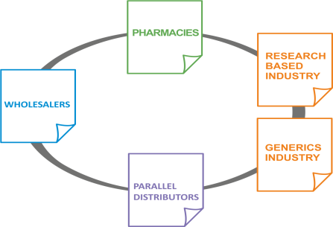
It is the obligation of the Pharma Industry to establish the repositories system
The repositories system shall be set up and managed by a non-profit legal entity (NMVO) established in the Union by manufacturers and marketing authorisation holders of medicines in scope = those who must pay for the system
Wholesalers, persons entitled to supply medicinal products to the public and relevant national authorities shall be consulted and are entitled to participate in the legal entity on a voluntary basis free of cost (stated in the DR)
The statutes for the NMVO can state
different membership levels and voting
rights
The EMVO principle is “pay to vote”,
i.e. stakeholders wanting to be Full
Members should pay part of the NMVO admin cost

Slide 23











How charging works (examples, not real figures)
KDH
Pharmaceuticals
€ 81,000
231 Products
€ 15,000
52 Products
ABC
Pharmaceuticals
€ 60,000
6 Products
€ 18,000
45 Products
34 Products
34 Products
€ 19,000
25 Products
41 Products
2 Products
€ 12,000
1 Products
1 Products
€ 9,000
2 Products
1 Product
€ 5,000
€ 14,000
Tiny
Pharmaceuticals
€ 9,000
1 Product
€ 19,000
€ 14,000
€ 12,000
€ 19,000

Slide 24
Executive Summary Country Readiness April 2017
23
9
30
14
8
32
7
17
19
15
11
24
22
Early Adopter
Main Stream
Late Follower
No Information
Non EU Countries
2
10
6
20
27
1
13
26
31
18
16
28
4
29
3
25
12
21
5

Slide 25
Introduction: EU-FMD background
Safety Features – Impact on Stakeholders
EMVO, EMVS and NMVOs
Conclusion

Slide 26
The key elements of the EU-FMD
Serialization by manufacturer
Risk based verification by Wholesalers
Verification and check-out at point of dispense
Safety features:
UI = Code (‘unique identifier’)
+
ATD = Anti-Tampering Device
Product #: 09876543210982
Batch: A1C2E3G4I5
Expiry: 140531
S/N: 12345AZRQF1234567890
Manufacturers shall bear the cost of the repositories system
EMVO / NMVOs set up and operated by supply chain stakeholders
Oversight by competent authorities

Slide 27
All stakeholders need to play their role in the Europe-wide systems and processes
Wholesaler
National System
Pharmacy
Wholesaler
National System
National System
National System
Pharmacy
European Hub
Parallel Distributor
Brand Owner Obligations:
Ensure all Medicinal Products carry SF
Report UIs to EMVS via European Hub
Process Exceptions and Alerts
> Require a capable L4 Repository/EPCIS
MAH = Marketing
Authorisation Holder
= Brand Owner
National System
Pharmacy
Wholesaler
Notes:
But in parallel MFR readiness must be established.
The lessons from early adopters is that this is a major challenge taking a lot of time and effort.
The sooner manufacturers start, the better.
Don’t forget: If you are not ready by February 2019, you can no longer supply the European Markte!
***

Slide 28
Thank you very much
Mart Levo
Mart Levo@reks.ee

Slide 29
Glossary
BP - Blueprint System
DR - Delegated Regulation
EMVO - European Medicines Verification Organisation
EMVS - European Medicines Verification System
FMD - Falsified Medicines Directive
MOU - Memorandum of Understanding
NBPS - National Blueprint System
NMVO - National Medicines Verification Organisation
NMVS - National Medicines Verification System

