Slide 1








Proposals from the European Pharmaceutical Industry for PiE (Pharmaceuticals in the Environment)
2017 China/EU Pharmaceutical Industry Forum, in Shanghai, May 17, 2017
^{Author: Bengt} ^{Mattson} ^{* Date: April} ^{28, 2017 *}
Presentation
^{www.efpia.eu}

Slide 2
Why is managing environmental impacts from pharmaceuticals important?
First, and foremost, we all need to do what we can to protect the environment.
The ecosystem serves our community, protecting it improves quality of life
It’s good “business-sense”
Stakeholder concerns are prompting regulators to take actions that will impact our business model
Sustainable investors and product procurement programs are extending their research across the supply chain and considering the addition of “environmental considerations” to their decision-making process

Slide 3





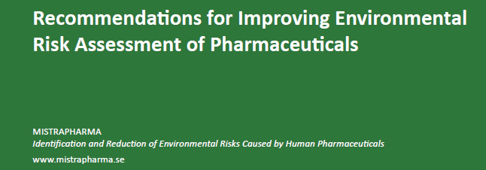
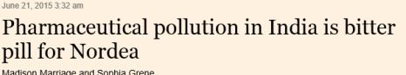
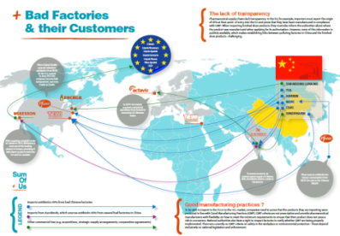
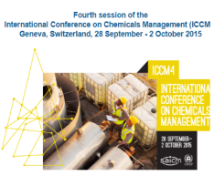

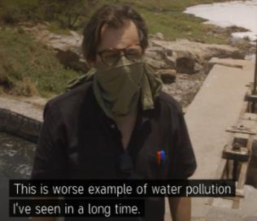
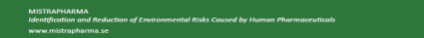
Stakeholders voicing their concerns
Focus on the Pharmaceutical Supply Chain
Mistra Pharma - Swedish research center briefs EU Parliament, recommends including manufacturing losses in drug approval decision
Sum of Us – Activist group proposes link between antibiotic contamination from Chinese suppliers and antimicrobial resistance. The report, ‘Bad Medicines’ names several major companies
Nordea - The largest Nordic financial services firm expresses concerns with water pollution in India from pharmaceutical suppliers
SAICM – UNEP declares pharmaceuticals as a new emerging policy issue with focus on developing countries
1
2
3
4

Slide 4
A Global industry acts with global standards

Slide 5
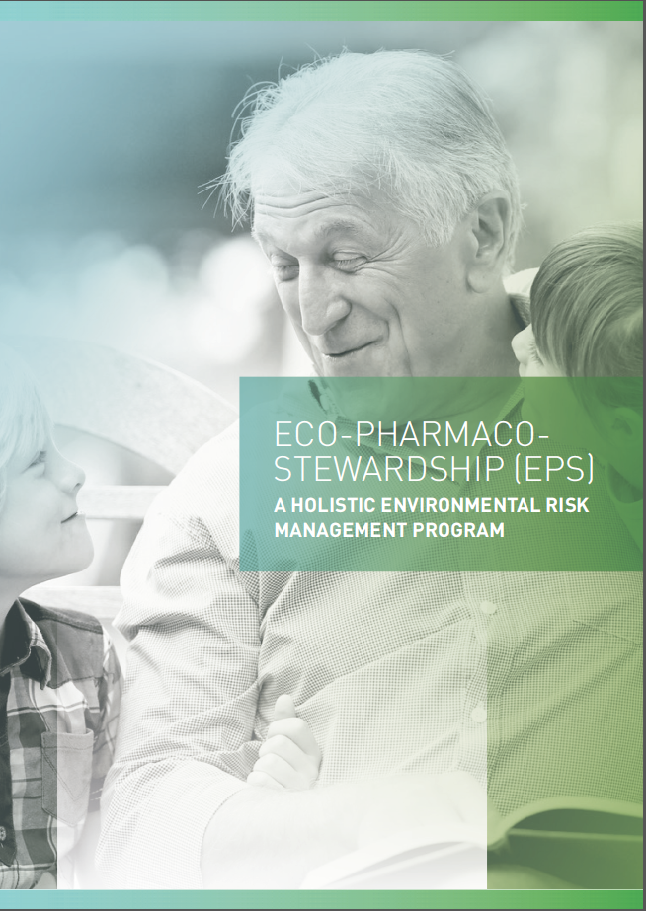
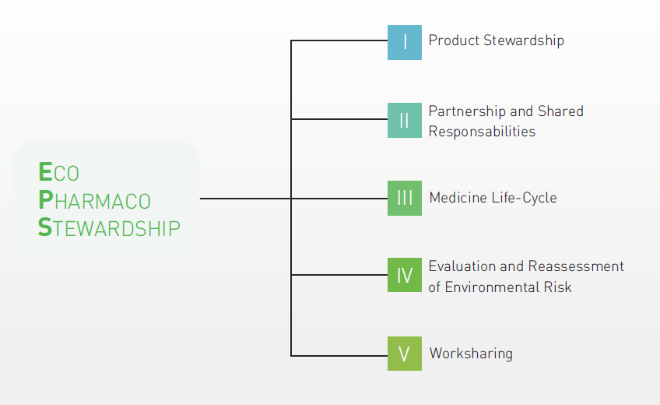
A proposal from the European Pharmaceutical Industry for managing environmental impacts from pharmaceuticals: Eco-Pharmaco-Stewardship (EPS)
Recognizing the need for a tailored approach to the environmental management of pharmaceuticals, the industry proposes a holistic program, based upon a life-cycle approach, aimed to address environmental concerns while leaving patient access to medicines unimpeded

Slide 6
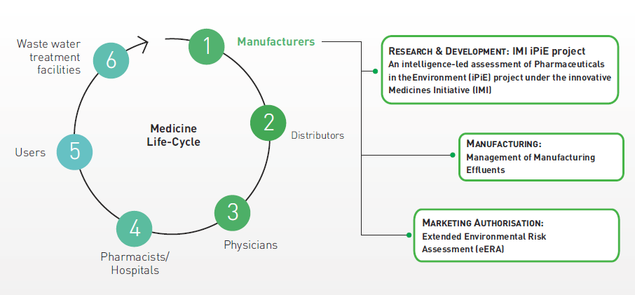
Eco-Pharmaco-Stewardship (EPS): a life-cycle approach
Objective: Providing knowledge and data enabling
assessments of sustainability of pharmaceuticals
A joint initiative by EFPIA, MfE, and AESGP,
and supported from additional international federations, e.g. PhRMA, JPMA

Slide 7
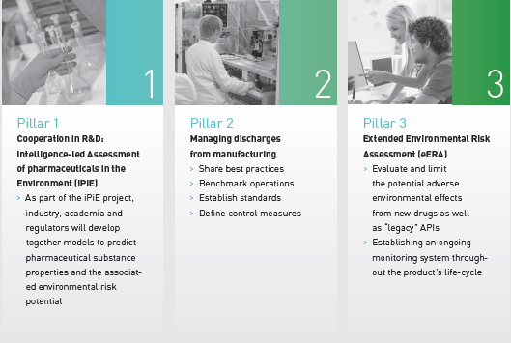
Priority EPS Activities
Extension of Scientific Knowledge Base (multi-stakeholders)
Effluent emission control from manufacturing
Extended Environmental Risk Assessment (eERA)
IMI “iPIE”project
Industry Guidance
for effluent control
Post-Authorisation
ERA model
Developing a high quality eco-database
Develop effects & exposure prediction models
Addressing prioritization methodology for legacy products and R&D
Establish risk based control
Give technical guidance (e.g. PSCI)
Sharing practices
The environmental aspect of AMR (Antimicrobial Resistance)
Provides a framework for ongoing environmental review post launch and
a mechanism to follow up on identified risks
Not compromising patient access to medicines

Slide 8

IMI “iPIE”project
Overview:
10.3 M Euro four year partnership between industry and the EC
Ends on 31/12/2018
Participants include 13 pharmaceutical companies, 4 SMEs and 8 non-industry partners (includes UBA)
Project Objectives:
To develop tools and models that:
allow environmental concerns to be identified earlier in drug development
allow the effective prioritisation and testing of legacy APIs recognising that >90% of tested APIs pose low or insignificant environmental risk
Further details can be found at
http://www.imi.europa.eu/content/ipie

Slide 9
EPS Pillar 2: Managing pharmaceutical sites’
effluents efficiently
Minimize API discharges from manufacturing sites by exchanging good practices
Internal/external benchmarking through a “wastewater maturity ladder”
Improve effluent quality where necessary
Research with academia and water companies
Make environmental sustainability part of the company culture
Efforts to educate the supply chain:
Pharmaceutical Supply Chain Initiative (PSCI) webinars to build capacity within external manufacturers
Guidance document published in public literature, for use by SMEs and suppliers
Future follow-on webinars in planning

Slide 10
Internal/external benchmarking Wastewater Maturity Ladder
High-Level
Advanced
Step 6
Integrate & maintain continuous improvement
*Process technology reviewed and evaluated for BAT
*If direct discharge , is TIE (Toxicity Identification Evaluation) done?
-Whole effluent testing (acute/chronic)
*If direct discharge , is TRE (Toxicity Reduction Evaluation) done?
-Techniques to reduce toxicity tested implemented?
*Rational water management
-Awareness campaign
-Effluent reuse
-Rainwater capture/use
*Advanced training including microscopic sludge analysis
-Microorganism activity level
-Floc forming bacteria identification (staining)
-Filament identification
Minimum
Step 4
Control Risks
*Wastewater acceptance policy
-Dedicated acceptance person
-Awareness of the impact of new waste streams
-Procedures available/in place
*Awareness/evaluation of value of microscopic sludge analysis?
*Water consumption optimization awareness
*Preventative maintenance program
*Trending of important parameters and process deviations
*Operational WWTP emergency procedure
-Back-up power available
-Failure alarm system for critical equipment
-Personnel available 24/7
Step 5
Audit/Benchmark
Share/implement best practices
*Opportunities for improvement identified and evaluated
-Audit of production and WW treatment as they relate to each other
-Evaluation of water and product use in production to investigate technology efficiency and effectiveness
*Have operational efficiencies been benchmarked and improvements evaluated?
-Comparison of performance of similar plants in order to optimize
-Comparison of operational costs of similar plants in order to optimize
Step 3
Assess Risks
*Removal efficiency of organics and nutrients evaluated and in line with design
-COD, BOD, N, P removal
*Rest capacity understood
*Spill/Calamity control in place
-Awareness
-Procedures available/in practice
*Advanced training
-WWT organizations
-Follow-up training
-Advanced data interpretation and evaluation
*Integration of production planning and WWT capacity/capability
*Evaluation of water and pollution balance
-Water consumption in production? Rainwater
-Sound water and mass balance
Step 2
Easy fixes, quick wins, must do’s toward prevention and compliance
*Communication link WWTP w/Production
Communication and Planning
*Basic spill /calamity procedure
-Calamity tank available
-External processing
*Regular follow-up of WWTP
-Influent characterization
-Sludge characterization
*Redundant critical equipment
-pumps, blowers available
*WWTP laboratory safe and controlled
-General lab safety rules
-Regular instrument calibration
Step 1
Commit & Plan
Basic awareness & knowledge
*Legal compliance and knowledge about fate and nature of effluent
-Fate of effluent known and fully permitted
-yearly discharge volume accounted for
*Monitoring effluent characteristics and standards
*Dedication of assigned persons for WWT
*Basic training of WWT responsible persons
*Understanding design capacity and performance

Slide 11
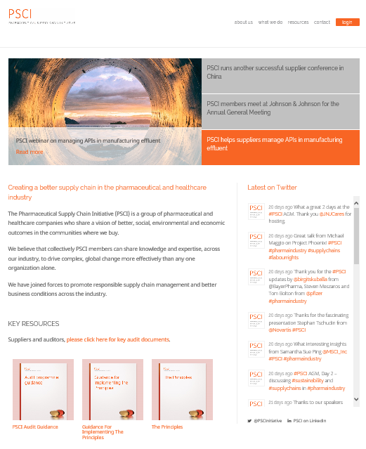
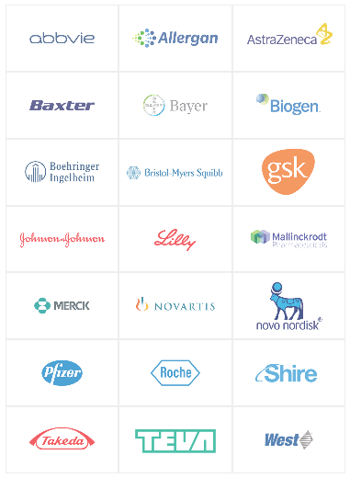
Pharmaceutical Supply Chain Initiative
www.pharmaceuticalsupplychain.org
Initiatives, partly related to EPS
Disclaimer: Not all EFPIA members are part of PSCI

Slide 12
PSCI Principles
Ethics
Business Integrity and Fair Competition
Identification of Concerns
Animal Welfare
Privacy
Labor
Freely Chosen Employment
Child Labors and Young Workers
Non-Discrimination
Fair Treatment
Wages, Benefits and Working Hours
Freedom of Association
Health and Safety
Worker Protection
Process Safety
Emergency Preparedness and Response
Hazard Information
Environment
Environmental Authorizations
Waste and Emissions
Spills and Releases
Management Systems
Commitment and Accountability
Legal and Customer Requirements
Risk Management
Documentation
Training and Competency
Continual Improvement

Slide 13
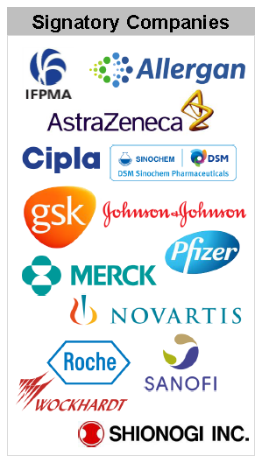
AMR Roadmap
http://www.ifpma.org/wp-content/uploads/2016/09/Roadmap-for-Progress-on-AMR-FINAL.pdf.
Published on Sept 20, 2016
Initiatives, partly related to EPS
Industry Roadmap for Progress on Combating Antimicrobial Resistance – September 2016
The Davos Declaration* signed by >100 companies and trade associations in January 2016, called for collective action to create a sustainable and predictable market for antibiotics†, vaccines and diagnostics, that enhances conservation for new and existing treatments. It also called for coordinated action to improve prevention of infections, hygiene, stewardship and conservation measures.
As a group of leading companies supporting the Davos Declaration, we welcome the continued high level political focus on Antimicrobial Resistance (AMR), including discussions at the UN, WHO, G7, G20, the AMR Review team’s Final Report as well as regional and national debate. This work has established an ambitious, comprehensive agenda for the world and challenges each key stakeholder group to act and contribute to managing the threat of resistance.
We support measures to reduce environmental impact from production of antibiotics
We are committed to antibiotics only being used in patients who need them
For existing and future antibiotics, diagnostics and vaccines, improved access is essential, and must be balanced with health system measures to ensure appropriate use. We support mechanisms to facilitate affordable access to high quality new and existing antibiotics, diagnostics and vaccines to the patients who need them, in all parts of the world and at all levels of income
We support new ways of working such as open collaborations between industry and public researchers to overcome the scientific challenges of creating new antibiotics, vaccines and diagnostics
Disclaimer: Not all EFPIA members are part of PSCI

Slide 14
Post-Authorisation
ERA model
A Proposal for extended Environmental Risk Assessment throughout the Lifecycle of a Medicine – eERA
Expected Benefit | The eERA model addresses questions from scientific, environmental and economic perspectives as it takes account of all products containing the same API and calls for risk management resource deployment as and when an established risk is identified. eERA will also improve the scientific rigor of the current ERA by ensuring that it reflects the latest published research findings.

Slide 15
Benefits of eERA Framework
Risk identification, refinement and management is performed for new molecules / chemical entities during authorization process with appropriate follow-up responsibilities defined
eERA does not stop with authorization of new molecules / chemical entities – Ongoing ERA review of pharmaceuticals post-approval and launch will ensure the ERA reflects the latest environmental information
eERA provides a risk assessment based on compound – Total risk from all human medicinal products containing the same active ingredient is considered (total PEC approach)
eERA addresses many concerns on the potential for duplicate regulation, duplicate testing and conflicting ERAs

Slide 16

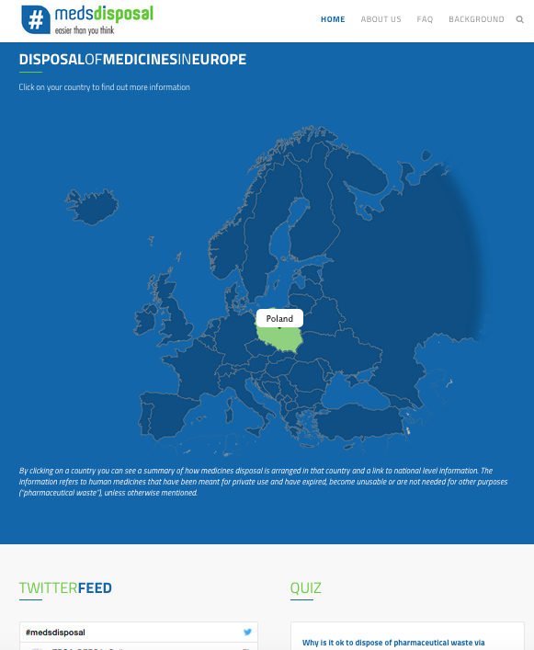
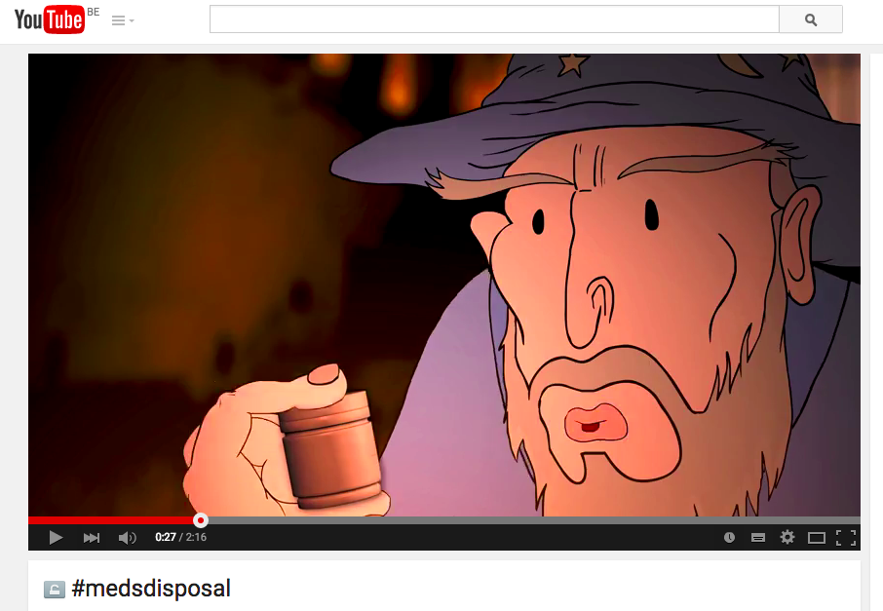
Other Initiatives under EPS:
Correct Disposal of Pharmaceuticals
Raising awareness of the correct disposal of unused and expired medicines with multi-stakeholder Social Media Campaign #medsdisposal
Successful campaign since June 2015 – National outreach on-going
Figures to date (April 2017)
The medsdisposal website has >8000 unique page views
The medsdisposal video on YouTube has nearly 4500 views (now including subtitles for major EU languages)
There are > 1000 tweets #medsdisposal and >3 000 000 impressions (the total outreach)
Facebook page has > 2000 Likes
Link to the website: http://www.medsdisposal.eu
Link to the video: https://www.youtube.com/watch?v=KJCDrCkylnE

Slide 17
To conclude:
The pharmaceutical industry takes a positive role in the debate on Pharmaceuticals in the Environment (PIE) and acknowledges the concerns of stakeholders:
We focus on delivering treatment options that allow people to live longer, healthier and more active lives.
We aim to do this without compromising our responsibility to minimize impact to the environment.
We acknowledge that pharmaceuticals, among a variety of other substances, are present in the environment

Slide 18
To conclude (cont.):
The Pharmaceutical industry wants to play an active role in helping developing proportionate and science-based measures to protecting the environment against any direct or residual impacts of its work in bringing life changing medicines to patients.
Access to medicines is paramount for patients and society and impact on access should form a key part of policy making on PIE

Slide 19
Thank you!
^{EFPIA Brussels Office}
Leopold Plaza Building * Rue du Trône 108
^{B-1050 Brussels * Belgium}
^{Tel: + 32 (0)2 626 25 55}
^{www.efpia.eu * info@efpia.eu}

