Slide 1
EU System for Marketing Authorisation
China/EU Pharmaceutical Industry Forum, 16 May 2015, Shanghai
Anette Hjelmsmark,
EFPIA China Regulatory Network,

Slide 2

Topics to Be Covered
The European Health Authority Set-up
Enablers Facilitating Development of Medicines
Marketing Authorisation Procedures
Marketing Authorisation Holder Concept
Summary and Recommendations

Slide 3

The European Health Authority Set-up
The EC*
The European Medicines Agency
The National Health Authorities in the Member States
Provides experts and resources
EU policy and legal framework
Commission Decision = Marketing Authorisation
The Committee for Medicinal Products for Human Use
7 Scientific Committees:
National applications
*European Commission
Notes:
Covers more than 500 million inhabitants and 24 languages
European Commission (EC)
Located in Brussel, Belgium
Responsible:
drafting the EU policy and legal framework:
Directives (to be incorporated into national legislation e.g. 2001/83/EC as amended 2004/27/EC
Regulations automatic entry into force and binding in all Member States e.g. EEC/2309/93 as amended EC/726/2004
Notice to Applicants (NtA) - guidelines
issuing the Commission Decision = the Marketing Authorisation for products approved via the Centralised Procedure (CP) covering 28 MS + Norway and Iceland
European Medicines Agency (EMA)
Established 1995, located in London- celebrates its´20 years anniversary this year
Reports to the European Commission
Responsible for:
Coordinating the existing scientific resources of Member States (MS):
Administers seven Scientific Committees
Contact point for the applicant
Product Team Leader (PTL)
Procedures for approval, surveillance and withdrawal
Surveillance of marketed medicinal products
Databases and electronic communication
A Networking Agency
The Scientific Committees
CHMP Committee for Medicinal Products for Human Use
PRAC Pharmacovigilance Risk Assessment Committee
PDCO Paediatric Committee
COMP Committee for Orphan Medicinal Products
CAT Committee for Advanced Therapies
HPMC Committee on Herbal Medicinal Products
CVMP Committee for Medicinal Products for Veterinary Use
The committees carry out the scientific evaluation of applications within the scope of the Centralised Procedure (CP)
Assessments are based on scientific criteria to determine whether or not the medicine meet the necessary quality, safety and efficacy requirements in accordance with EU legislation
The Committee for Medicinal Products for Human Use (CHMP)
Chairman (Dr Tomas Salmonsen ) & Vice-Chairman (Dr Pierre Demolis )
1 scientific expert member nominated by each MS and 1 alternate
1 scientific expert member from NO and IS and 1 alternate
Up to 5 co-opted members
Responsible for:
appointing Rapporteur and Co-Rapporteur
preparing EMA´s opinions on all questions concerning medicines for human use, in accordance with Regulation EC/726/2004 :
Integrate input from other scientific committees as relevant
delivering CMHP opinions to the European Commission
publishing an European Public Assessment Report (EPAR) for medicines which are granted a marketing authorisation (MA) via the Centralised Procedure (CP)
providing scientific advice to companies
advising on general EU guidelines and policies
contributing to International Conference on Harmonisation (ICH) process
establishing working parties and expert groups as necessary
Working Parties
Established by the CHMP
Have a three year mandate
Members chosen based on expertise in a scientific field
Appointed from European list of experts
Provide input to the CHMP on:
Scientific issues
Scientific evaluation of Marketing Authorisations
Drafting & revision of guidelines
National Health Authorities
More that 30 HAs located in the 28 EU Member states + Norway and Iceland
Responsible for:
the purely national applications
being involved in applications via the Mutual Recognition Procedure (MRP) or the Decentralised Procedure (DCP)
providing experts and CHMP members to the EMA system

Slide 4
The European System a (De)Centralized Network
European
Medicines
Agency
(EMA)
Committee for Medicinal
Products for Human Use
(CHMP)
Paediatric Committee
(PDCO)
Pharmacovigilance Risk
Assessment Committee
(PRAC)
Committee of
Advanced
Therapies
(CAT)
Committee for Medícnal
Products
for Veterinary Use
Committee of Herbal
Medicinal Products
(HMPC)
Working Party
Working Party
Committee of Orphan
Products (COMP)
Member State
Working Party
Working Party
Working Party
Working Party
Working Party

Slide 5
  EU Regulatory System Principles
Evolved over time and focusing on:
Aligned, well defined procedures and requirements ensuring:
Specified timelines
Science based regulatory requirements:
Benefit risk assessment
Harmonisation
Optimal use of resources
Transparency
ICH** guidelines
EMA* guidelines
For the benefit of patients
*European Medicines Agency
**International Conference on Harmonisation

Slide 6
Enablers Facilitating Development of Medicines

Slide 7
Enabler – Well Defined Processes
Separate procedures for:
Clinical Trial Application (CTA)
Marketing Authorisation Application (MAA)
Life Cycle Management:
Supplementary Applications (variations, line extensions)
Renewals
Procedures are independent of the origin of the drug:
Companies based in EU as well as outside
Approval is not linked to other countries/regions outside EU

Slide 8
Enabler - Documentation Requirements
Separate for:
  Clinical Trial Application (CTA)
  Marketing Authorisation Application (MAA)
  Life Cycle Management:
    Supplementary applications (variations, line extensions)
    Renewals
Depend on the status of the drug:
  Reflects the development stage
    A smaller Clinical Trial Application (CTA) summary file compared with the comprehensive Marketing Authorisation Application (MAA)
  Reflects the type of drug:
    Biologic*, Chemical
    Generic, Biosimilar, Originator
*includes vaccines

Slide 9
Enabler - Scientific Advice via Agency Interaction
During development*
Advice on appropriate tests and studies
Can be asked for at any point in the development
Advice is not binding
Before submission of Marketing Authorisation Application (MAA)
Provide information allowing for the finalisation of applications typically addressing product specific questions
Could be Legal, Regulatory, Scientific Issues
Facilitate the development and availability of medicines
Advice improves approval success rate
*also possible in Life Cycle Management e.g. new indication or formulation
Notes:
Agency interactions during development and prior to submission of the MAA plays an important role in facilitating the development of new medicines.

Slide 10
  Enabler – System Allowing Changes During a Clinical Trial
It can be necessary to make a change:
during the evaluation of the Clinical Trial Application (CTA)
during the Clinical Trial (CT)
Changes during a Clinical Trial must be submitted to Health Authorities if they are likely to:
impact safety of trial subjects
change the interpretation of scientific documents in support of the Clinical Trial
significant in other ways

Slide 11
Marketing Authorisation Procedures

Slide 12
EU Authorisation/Registration Procedures
A medicinal product may only be placed on the market in the EU when a Marketing Authorisation has been issued by:
the competent authority of the Member State(s) (MS)
or by the European Commission (EC)
Same legal requirements irrespective of the route/procedure for the authorisations - granted on the basis of quality, safety and efficacy.
Centralised Procedure (CP)
Mutual Recognition Procedure (MRP)
Decentralised Procedure (DCP)
National Procedure (NP)

Slide 13
Centralised Procedure Key Benefits
Predictable and predefined timelines
One Member State (MS) as Rapporteur and one as Co-Rapporteur
  One assessment & scientific opinion
  One Marketing Authorisation (28 Member States)
  One Trade Name for all countries
  Uniform labelling across languages
  Maximum Agency review period of 210 days (opinion by Committee for Medicinal Products for Human Use (CHMP))
But it does not cover market access i.e. price and reimbursement

Slide 14

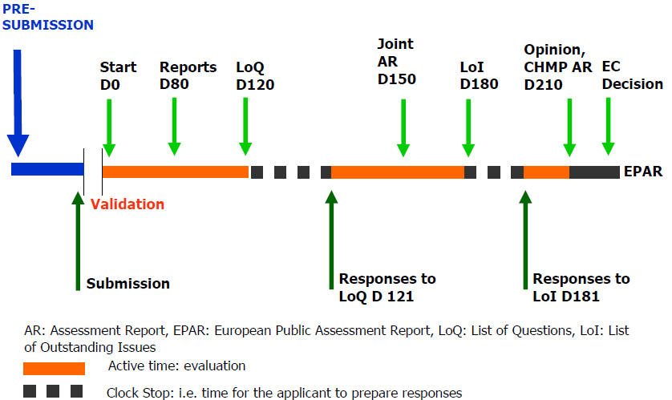
Centralised Procedure Timelines
Source: Falk Ehmann, EMA presentation 2011

Slide 15
Life-Cycle Management
ONE Marketing Authorisation per medicinal product
SAME Marketing Authorisation for the product throughout the entire lifecycle – same Rapporteur/Co-Rapporteur
Variations
Change in
analytical method
New Safety
information
Marketing
Authorisation
Approval
Batch size
increase
Additional
manufacturing site
New paediatric indication
Medicinal Product Lifecycle

Slide 16
Reasons for Making Post-approval Changes
Ensure market access and continuous supply of live-saving medicines to patients by reacting to supply demands
Support continuous improvement and optimization of manufacturing process and ensure the quality of the medicinal products
Remain state of the art with manufacturing methods and analytical techniques
Fulfill regulatory agency requirements

Slide 17
The Marketing Authorisation Holder Concept (MAH)

Slide 18
The Marketing Authorisation Holder Concept
Described in the EU Directive 2001/83/EC:
applies to all types of products
1 Marketing Authorisation (MA) - 1 Marketing Authorisation Holder (MAH)
The Marketing Authorisation Holder:
must have a legal address in the EU
is legally accountable for Quality, Safety and Efficacy of the product
Manufacturing of the drug product:
can take place in- or outside the EU
multiple manufacturing sites are allowed on the same Marketing Authorisation (MA)
quality must be verified by Good Manufacturing Practice (GMP) status and inspection

Slide 19
Marketing Authorisation Holder Responsibilities
Provide Documentation
Launch and market the product
Legally responsible for the
Quality, Efficacy and Safety throughout the life cycle
Maintain the Marketing Authorisation
Renew Marketing Authorisation
Inform the EU Health Authorities if new information is available (e.g. safety)
Inform the EU Health Authorities about plans to discontinue or de-register the product

Slide 20
Summary

Slide 21

Summary - Separate Clinical Trial and Marketing Authorisation Approval Procedures
One
Separate Clinical Trial Application (CTA) per trial
One
Marketing Authorisation Application (MAA)
One
Marketing Authorisation (MA) issued to the Marketing Authorisation Holder (MAH)
Transparency, Timeliness and Predictability
Benefit – Risk Assessment
Science based data requirements, globally harmonised

Slide 22
Recommendations

Slide 23
EFPIA Recommendation (1 of 2)
Implement enablers facilitating the development of medicines
Designated Clinical Trial Application (CTA) approval process
  System allowing changes during a clinical trial
Separate documentation requirements reflecting the development stage
  A smaller, summary Clinical Trial Application file compared with a comprehensive Marketing Authorisation Application (MAA)
Step up Scientific Advice and Pre-submission interactions
Ensure availability of science based guidelines reflecting ICH standards and thinking

Slide 24
EFPIA Recommendation (2 of 2)
Introduce a Marketing Authorisation Holder Based System
Separate procedure and documentation requirements
Applicable for importing companies as well as local producers
Companies can become Marketing Authorisation Holder (MAH) without having local production facilities
Multiple manufacturing sites can be on the same licence
Relax the dependency of approval status in other countries/regions and the requirement for a Certificate for Pharmaceutical Product (CPP)
CFDA has the expertise to perform scientific review and assessment of the application
Certicificat of Pharmaceutical Product (CPP) can be provided at the time of Drug Approval

Slide 25



Slide 26
Acronyms
CMC: Chemistry, Manufacturing and Control
CMDh: Co-ordination Group for Mutual Recognition and Decentralised Procedures – human (CMDh),
CPP: Certificate of Pharmaceutical Product
CTA: Clinical Trial Application
CT: Clinical Trial
EMA: European Medicines Agency
EC: European Commission
EEC: European Economic Community
EU: European Union
GMP: Good Manufacturing Practice
ICH: International Conference on Harmonisation of Technical Requirements for Registration of Pharmaceuticals for Human Use
MA Marketing Authorisation
MAA: Marketing Authorisation Application
MAH: Marketing Authorisation Holder
MS: Member State
NDA: New Drug Application

Slide 27
EFPIA Brussels Office
Leopold Plaza Building
Rue du Trône 108
B-1050 Brussels - Belgium
Tel: +32 (0)2 626 25 55
www.efpia.eu

Slide 28
Useful Links
Directive 2001/83/EC on the Communicty Code relating to Medicinal Products for Human Use: http://ec.europa.eu/health/files/eudralex/vol-1/dir_2001_83_consol_2012/dir_2001_83_cons_2012_en.pdf
Regulation (EC) no. 726/2004 laying down Community procedures for the authorisation and supervision of medicinal products for human and veterinary use and establishing a European Medicines Agency: http://ec.europa.eu/health/files/eudralex/vol-1/reg_2004_726/reg_2004_726_en.pdf
Eudralex: http://ec.europa.eu/health/documents/eudralex/index_en.htm/
EMA Pre-authorisation guidance: http://www.ema.europa.eu/ema/index.jsp?curl=pages/regulation/general/general_content_000197.jsp&mid=WC0b01ac058002251c
CMDh homepage: http://www.hma.eu/cmdh.html

Slide 29

Back-Up

Slide 30
BACK-up Possibilities for Agency Interaction During Development
Scientific Advice (end of phase 2)
Non-clinical results
First Human Dose (Phase 1)
Dose finding (Phase 2)
Safety and Efficacy (Phase 3)
Pre-submission Meeting
Scientific Advice
Example ONLY
Nonclinical Clinical MAA Submission
CMC Development

Slide 31
Back-up Summary of Procedures
Centralised Procedure (CP) | Mutual Recognition Procedure (MRP) | Decentralised Procedure (DCP) | National Procedure (NP)
One submission to EMA | Sequential approach RMS* followed by CMS(s)** | Parallel submission to RMS and CMS(s) | National submission
One approval (European Commission) | National approval | National approval | National approval
No choice of Rapporteur and Co-Rapporteur | Applicant can decide on RMS | Applicant can decide on RMS | N/A
All Member States (incl. NO/IS/LI) | Applicant can decide on CMS | Applicant can decide on CMS | One country
Identical labelling in all Member States | Identical labelling, national additions possible | Identical labelling, national additions possible | N/A
Procedure timelines: 210 + 67 days | Procedure timelines: 210 + 90 + 30 days | Procedure timelines: 120/210 + 30 days | Procedure timelines: Individual
*Reference Member State, **Concerned Member State

Slide 32
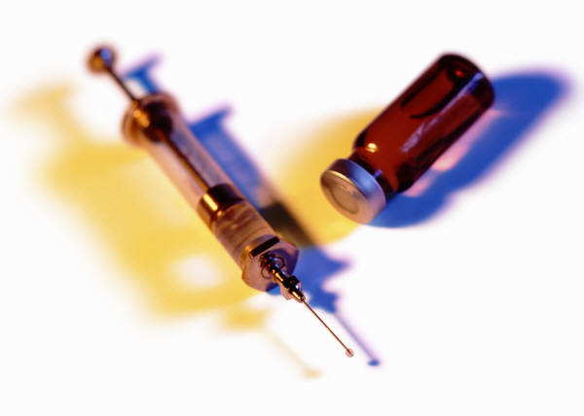
BACK-UP Centralised Procedure Products in Scope
Mandatory for all Biotechnology Products
Current mandatory therapeutic scope: medicinal products used for the treatment of:
  HIV/AIDS
  Neurodegenerative disorders
  Diabetes
  Cancer
  Viral Diseases
  Advanced Medicinal Products
  Orphan Diseases
Possible for Innovative New Pharmaceuticals
Further details can be found in:
the Regulation (EC) no. 726/2004: http://ec.europa.eu/health/files/eudralex/vol-1/reg_2004_726/reg_2004_726_en.pdf
and the EMA Pre-authorisation guidance: http://www.ema.europa.eu/ema/index.jsp?curl=pages/regulation/general/general_content_000197.jsp&mid=WC0b01ac058002251c

Slide 33
Back-up EU History and Development
Key Milestones
1957: European Economic Community (EEC) established, the Rome Treaty signed
1965: First Directive concerning protection of public health
1975: First Directive concerning pharmaceutical testing
1993: The European Union (EU) is the official name
1993: EEC/2309/ 93 covering new regulation and EMEA establishment
1995: EMEA established
1995: New EU legislation incl. registration procedures
1997: Amsterdam treaty
1999: The EURO currency (€) is introduced
2010: EMEA becomes EMA
2012: ”Pharma Package” including the Falsified Medicines Directive
New Member States
1958: Germany, Italy, France, Belgium, Luxembourg and The Netherlands join (6)
1973: The United Kingdom (UK), Ireland and Denmark join (9)
1981: Greece joins (10)
1986: Spain and Portugal join (12)
1995: Austria, Finland and Sweden join (15)
1995: Iceland, Norway, Lichtenstein adopt the EU medicinal products legislation (15+3)
2004: 10 new Member States* join (25+3)
2007: Romania and Bulgaria join (27+3)
2013: Croatia joins (28+3)

Slide 34
Back-up Enabler - Clinical Trial Process- On a Journey Towards Harmonisation (1)
?
high
2016
Clinical Trial Regulation into force
2014
Clinical Trial Regulation adopted
2012
Clinical Trial Regulation
Degree of harmonisation
2009
Evaluation of the Clinical Trial Directive initiated
2008
Voluntary Harmonisation Procedure
2004
Clinical Trial Facilitation Group
2001
Clinical Trial Directive
low
2000
Time (year)
2020

Slide 35
Back-up Enabler - Clinical Trial Process- On a Journey Towards Harmonisation (2)
Greater harmonisation
Improved timelines and flexibility
Effective administration and assessment
Increased transparency
Focus on informing the citizens of Europe (layman language)

