Slide 1
Drug Quality and Environmental Requirements
Expectations from European industry regarding collaboration on drug quality and environment

Slide 2

A Global industry acts with global standards

Slide 3
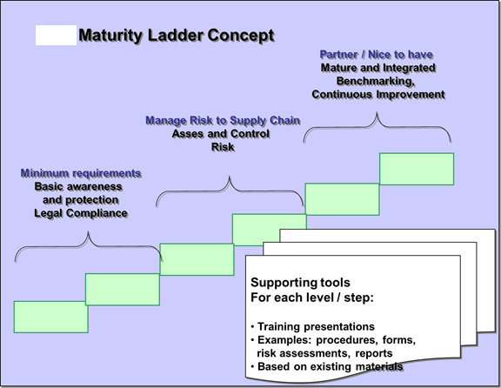
Excellence Builds on Continual Improvement

Slide 4
EFPIA and Drug Quality
EFPIA collaborations regarding manufacturing, e.g.
  Legislation via European Commission (EC)
  Coordination by the EU Regulatory Agency (EMA)
  Inspections with the 28 member states (Heads of Agencies)
  Pharmacopoeia (EDQM)
  Industry Associations: International/EU level
    EGA, APIC, IFPMA, PhRMA, JPMA etc.
Manufacturing is done in a global context usually at one site for all countries
Hence, common understanding and harmonisation is key
EFPIA welcomes convergence of regulatory and quality guidelines and requirements

Slide 5
Convergence of Regulatory and Quality Guidelines and Requirements
Contribution to the development of global regulatory and GMP standards is of great benefit to patients
  ICH Quality Guidelines etc.
  PIC/S (Pharmaceutical Inspection Convention and Pharmaceutical Inspection Co-Operation Scheme)
  WHO Good Pharmacopoeial Practices
Diversity of views and perspectives encourages the development of high quality, scientifically sound, and technically excellent global standards
Efpia welcomes engagement by Chinese regulatory authorities and industry to contribute to the development and adoption of these global regulatory guidelines and initiatives

Slide 6
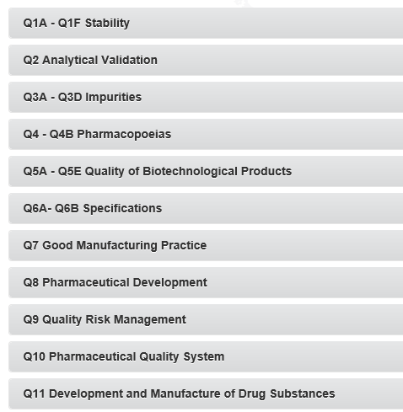
ICH Quality Guidelines
Guidelines established uniform requirements across a range of important topics
More conceptual guidelines promoting science- and risk-based approaches to development and manufacturing

Slide 7
Pharmaceutical Inspection Cooperation Scheme (PIC/S)
All PIC/S member inspectorates have equal rights
  Depending on their resources some are more or less active
Harmonization of requirements
  Discussion forums like PIC/S facilitate trust as basis for an enhanced collaboration among regulatory agencies
Good Inspection Practices (GIP) is based on standardised definitions, inspection templates etc.
  Facilitate opportunities for foreign inspectorates to accept the outcome of domestic inspections
Leveraging formal agreements, as necessary
  Optimise the use of inspection resources
Collaboration increases oversight on manufacturing sites

Slide 8
Global Standards for Product Testing -
The Intention
Goal
  Eliminate all re-testing of imported products or establish waiver schemes to reduce such requirements
Scope
  Pharmaceuticals, biological/biotechnology, vaccines
  APIs, finished and semi-finished products, and bulk drug products requiring final packaging
Efpia supports the IFPMA Position Paper ‘Appropriate Control Strategies Eliminate the Need for Redundant Testing of Pharmaceutical Products’ (April 2012)
http://www.ifpma.org/uploads/media/IFPMA_Position_Paper_on_Redundant_Testing.pdf
One Company, One Product, One Approval

Slide 9
Global Standards for Product Testing - Expected Benefits
Increased availability of medicines for patients, i.e.
  No supply interruptions due to import testing, and
  Earlier approval without registration testing
Less complex supply chain by reducing cycle time and inventories
Decreased costs within the health care systems and for the manufacturers
Reduced sampling/ testing and product wastage
  Avoid investigations (or even rejections) of good quality products associated with aberrant results from testing performed by laboratories with limited experience of the methods or product
Focus resources on innovation and improvement

Slide 10
Pharmacopoeial Standards
Pharmacopoeias are an important part of the regulatory framework established for the protection of public health
Differences in regional and national pharmacopoieal standards may result in:
  Multiple tests of the same quality attributes of materials or dosage forms → sub-optimal use of resources; increased environmental impact
  Increased supply chain complexity → negative impact on trade and availability of medicines for patients
To facilitate compliance with the Chinese Pharmacopoiea, Efpia would welcome:
  Adoption of monographs from the other major pharmacopoeias, wherever possible
  Longer commenting periods for proposed new monographs or revisions to existing monographs
  Timely provision of translations in a business language (e.g. English)
Convergence of Pharmacopoeial standards benefits patients, industry and regulatory oversight
Efpia encourages the Chinese pharmaceutical industry and regulators
to continue to support, adopt and promote the draft
WHO Good Pharmacopoeial Practices

Slide 11
EFPIA and Drug Quality: Key Messages
EFPIA welcomes convergence of regulatory and quality guidelines and requirements
Leverage Communication, Collaboration, and Trust
  Discussion forums like PIC/S facilitate trust as basis for an enhanced collaboration among regulatory agencies followed by harmonization of requirements
  Harmonized regulatory requirements makes collaboration through-out the supply chain less burdensome and allows for increased availability of medicines for patients
Implementation of global standards and good practices
  Could improve inspection oversight globally through resource sharing
  Improving the safety and quality of medicinal products
  Allows for more global sourcing contracts
Deploy inspectorates resources based on risk
  We support implementing risk based approaches for scheduling and conducting inspection to be used more widely
  Strong Quality Management Systems in the industry, and risk based inspection approaches, is a resource efficient way to secure the safety and quality of medicinal products

Slide 12
EFPIA and Environmental Quality
Leverage Communication, Collaboration, and Trust
Two industry examples of leveraging communication, collaboration, and trust
building “global standards”
Pharmaceutical Supply Chain Initiative
Eco-Pharmaco-Stewardship pillar “Effluent Emission Control from Manufacturing”

Slide 13
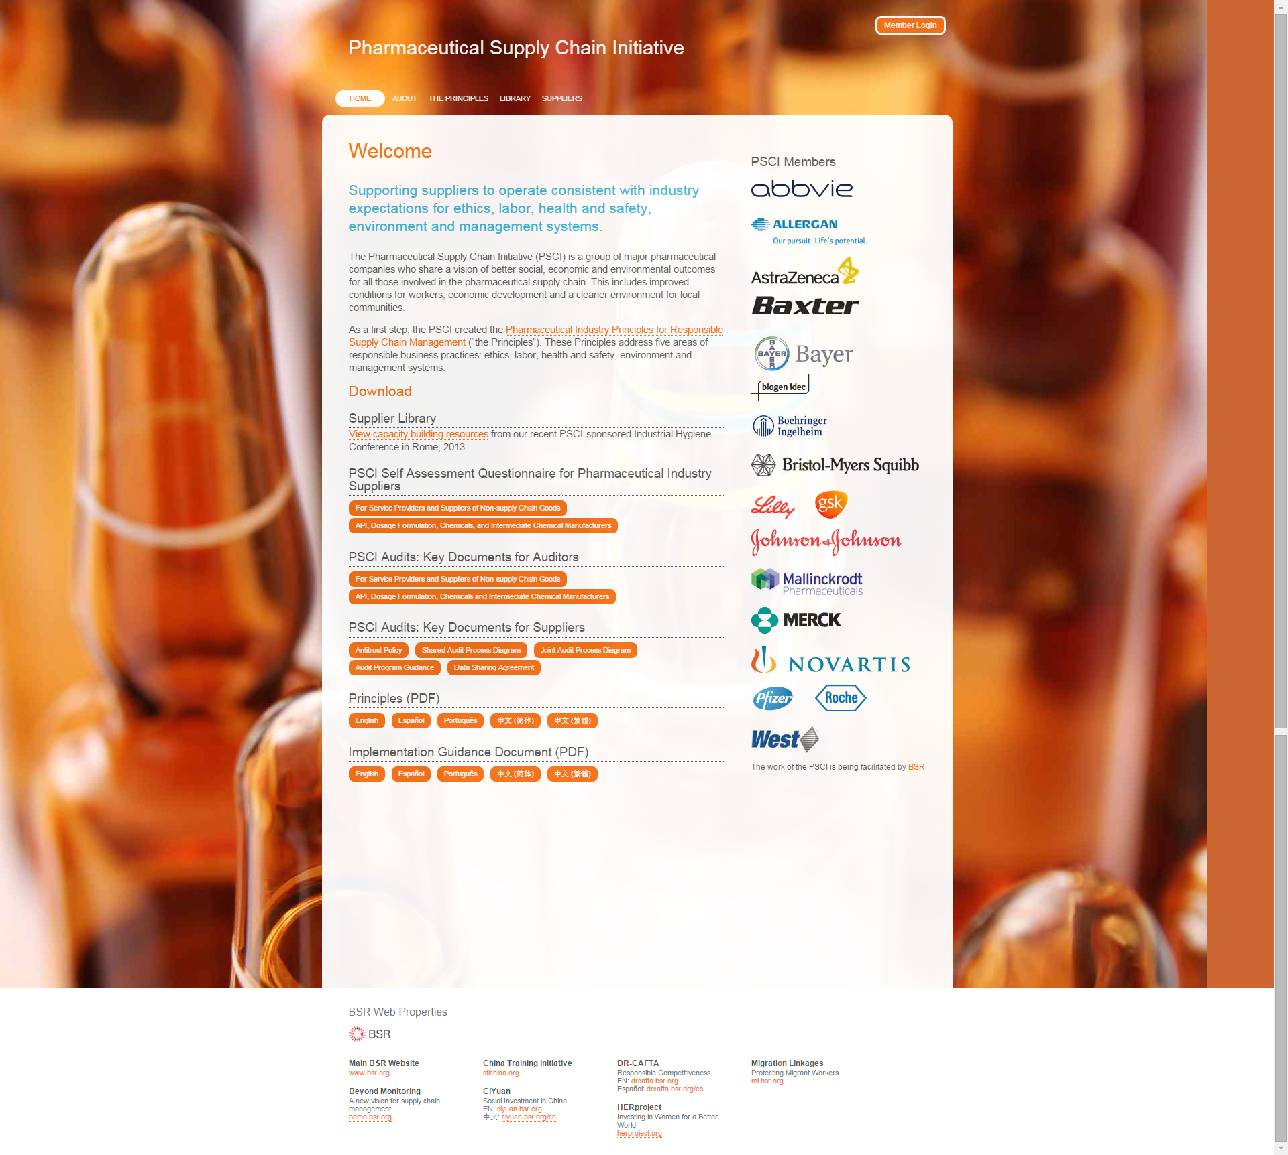
Pharmaceutical Supply Chain Initiative
www.pharmaceuticalsupplychain.org
Disclaimer: Not all EFPIA members are part of PSCI

Slide 14
PSCI Principles
Ethics
  Business Integrity and Fair Competition
  Identification of Concerns
  Animal Welfare
  Privacy
Labor
  Freely Chosen Employment
  Child Labors and Young Workers
  Non-Discrimination
  Fair Treatment
  Wages, Benefits and Working Hours
  Freedom of Association
Health and Safety
  Worker Protection
  Process Safety
  Emergency Preparedness and Response
  Hazard Information
Environment
  Environmental Authorizations
  Waste and Emissions
  Spills and Releases
Management Systems
  Commitment and Accountability
  Legal and Customer Requirements
  Risk Management
  Documentation
  Training and Competency
  Continual Improvement

Slide 15
Industry’s Eco-Pharmaco-Stewardship Initiative
Extended
Environmental
Risk Assessment
(eERA)
Extension of
Scientific
Knowledge Base
in cooperation
with stakeholders
Effluent emission
control from
manufacturing
Post-Authorisation
ERA model
IMI “iPIE”project
Industry Guidance
for
effluent control
Provides a framework for
ongoing environmental review
post launch and
a mechanism
to follow up on identified risks
Not compromising patient
access to medicines
Developing a high quality
eco-database
Develop effects & exposure
prediction models
Addressing prioritization
methodology for legacy
products
Support early R&D
Establish risk based control
Give technical guidance
Sharing practices
In focus for this presentation
A joint initiative by EFPIA, EGA, and AESGP

Slide 16
Industry Guidance for
Effluent Control
A guidance on how to assess and control the potential impact of API residues in manufacturing effluents
Expected Benefit | Broaden awareness, share practices and provide guidance resulting in improved performance of the management of manufacturing effluents

Slide 17
Expectations Based upon Manufacturing Effluent Control Guidance document
  Actions taken proportionate to the risk identified
  Established risk assessment procedures to be used
  A facility and product specific approach taken
  Practices shared amongst industry
Further:
  Practices of manufacturing effluent assessments and control is providing a useful tool to assess and improve effluent quality where necessary
  A manuscript describing the industry approach has
  been submitted to the journal “Environmental Toxicology&Chemistry”

Slide 18
Concluding Remark: Building Trust, Communication and Collaboration is a Continual and Stepwise Process
A maturity ladder is a stepwise approach of increasing capability, whereby sites progress from implementing the minimum requirements to legally operate the facility, and advance to assessing and managing e.g. drug quality and environmental risks throughout the supply chain.
Some sites may progress to mature facilities that benchmark practices with peers.

Slide 19
Acronyms
APIC: Active Pharmaceutical Ingredients Committee
EC: European Commission
EDQM: European Directorate for the Quality of Medicines & HealthCare
EFPIA: European Federation of Pharmaceutical Industries and Associations
EGA: European Generics Association
EU: European Union
EMA: European Medicines Agency
EPS: Eco-Pharmaco-Stewardship
GIP: Good Inspection Practices
GMP: Good Manufacturing Practice
IFPMA: International Federation of Pharmaceutical Manufacturers & Associations
JPMA: Japan Pharmaceutical Manufacturers Association
PhRMA: Pharmaceutical Research and Manufacturers of America
PIC/S:Pharmaceutical Inspection Cooperation Scheme
PSCI: Pharmaceutical Supply Chain Initiative

