Slide 1
Barriers to access to innovative medicines
Dr Richard Torbett
Chief Economist, EFPIA
China/ EU Pharmaceutical Industry Forum
Shanghai, 16 May 2015

Slide 2
Policy debate on health in recent years has been dominated by cost containment

Slide 3
Our challenge - to regain growth in Europe
Poor access to medicines
Worse health outcomes
Industry retreats from Europe
Focus on cost containment
More sustainable finance and better health outcomes
Economic Growth
Europe a more attractive commercial and investment environment
Focus on smart us of HC funds
Current vicious circle
Potential virtuous circle

Slide 4
Integrating policy thinking on these three elements could result in win-wins
Better
Outcomes
Potential win-wins
Sustainable
Financing
Thriving
Eco-System

Slide 5

However wide variations in health attainments remain across Europe, amounting to almost a decade of life expectancy
Health & Wealth
Life expectancy at birth – 2011
Life Expectancy at birth in 2011 (years))
While health outcomes have improved throughout Europe over the last 50 years, a 12% variation (equal to 9 years) in life expectancy exists between country with highest and lowest life expectancy.
Cumulative differences in life expectancy between each country and highest life expectancy amounts to over 1.22 billion life years.
While variations are most observable with recent accession markets, wide variations also exist in markets with highest life expectancy.
+12%
Source: World Health Organization (WHO): Database on life expectancy; The World Bank: Database on life expectancy at birth (both accessed 2013)

Slide 6
Looking to the future, Europe needs to find solutions to pressing demographic challenges that will impact health and social spending
Health & Wealth
Demographic Development*
System Impact: Severity, length and increased incidence
65+ Years
152mn
87mn
+75%
Increase in severity of Degenerative Diseases†
Mn people
+136%
Extended impact of Chronic Diseases∆
years
+16%
Increased incidence of Cancer♯
Mn cases
+16%
Source: * European Commission (2012); † Brookmeyer R et al. (2007); ∆ UK Dept. of Health (2010), European Commission; ♯ WHO (2013)

Slide 7
Despite the bleak demographic picture, it remains possible to move healthcare spending to a more sustainable trajectory
Health & Wealth
Healthcare Expenditure (% of GDP, EU27 average) under different scenarios
Healthcare expenditure in % of GDP (EU27 average)
Pure Demographic scenario:
Gains in life expectancy are assumed to be spent in disabled health while the number of years spent in good health remains constant. In this, the assumption is that health care cost per capita for each year of age remains constant in GDP per capita-adjusted terms over the whole projection period.
Constant Health scenario:
For each year and for each age/gender, the age-related expenditure profile is shifted outwards – i.e. providing modified values of cost per capita, which are then applied in the same manner as the pure demographic scenario. For the constant health scenario, the scale of the outward shift in the age-related expenditure profile is directly proportional to the increase in life expectancy for each cohort.
Improved Health scenario:
Similar to the constant health scenario, only the same outward shift is assumed to be multiplied by a factor of 2.
-23%
year
Source: European Commission: Projecting future healthcare expenditure at European level (2010)

Slide 8


Health is a major cause of productivity loss and early labour market exit, with many causes being addressable
Health & Wealth
Health as a cause of leaving job
Determinants for health-related early labour market exits in Austria (% of exists)
Left last job for
reasons of health
% of market exists
Age Group
Health related causes for loss of output
2/3 of lost output are due to mental health and cardiovascular diseases.
Note: Percentage of people that were previously employed and answered the main reason for leaving their job was ‘Own illness or disability”
Source: European Commission: Health of People of Working Age( 2011); European Commission: Health Systems and Health care in the EU (2012)

Slide 9

Medicines offer an opportunity to reduce the cost of productivity loss and disability by improving workforce health
Health & Wealth
Avoidable Productivity Losses, U.S., 2023*
COPD in selected European countries: % of GDP lost due to chronic disease†
Disease Area
% of GDP
Across Europe, a significant amount of people with chronic diseases had either gone into early retirement or were contributing less than productive peers.
Source: * Milken Institute: The Economic Burden of Chronic Disease (2007); † Respiratory Medicines Journal (2003)
Notes:
We need to make sure that health systems are geared up to identify those technologies – including medicines - that are likely to add value (and preferably reduce overall cost) versus those technologies (including medicines) that add less value. There are of course good examples, as you see here of where medicines can reduce the cost of productivity loss by improving the health of the workforce. This sort of evidence needs to be taken into account.

Slide 10

Overall medicines across Europe represent less than 15 % of total expenditure although variances exist between therapy areas
Sustainable Financing
Total healthcare expenditure by function (2010, pop.-weighted, current prices, PPP, $)*
Medicines contribution to disease cost (2011, various diseases)
Cost factor | COPD† | Diabetes† | CHF† | Alzhei-mers∆ | Prostate Cancer♯
Care | 21% | 8% | 6% | 9% | 34%
Hospitali-sation | 30% | 22% | 64% | 11% | 31%
Indirect Cost | 22% | 35% | 18% | 76% | N/A
Other Cost | 14% | 20% | 6% | 1% | 2%
Medication | 14% | 15% | 5% | 3% | 34%
Source: * OECD Health Statistics Database (accessed 2013); † A.T. Kearney analysis (2012); ∆ Schwarzkop et al. (2010); ♯ Damm el al. (2012)

Slide 11
Our basic medicines life cycle has formed the basis of our narrative for some time
Rapid patient access to modern medicines
Access to patient pool for clinical trials
Recognise and value innovation
Opportunity to generate realistic return
Enhanced competition post loss of exclusivity
System that supports R&D
25 years
Balance across the life cycle has kept the medicines bill in check, but there are new challenges

Slide 12










Combination of generic price erosion & price regulation resulted in a 16% decline in nominal medicines prices vs. a 25% rise in consumer prices
Sustainable Financing
Consumer Price Index (CPI) vs. Medicines Price Index, population weighted, year 2000 = Index 100
Population-weighted - Europe
Countries reporting Medicines Price Index Data
Index
Index
Index
Index
125
Index
Index
Index
Index
Index
84
Note Euro-denominated countries producing medicines price index only. Countries included: Austria, Belgium, Finland, France, Germany, Greece, Italy, Spain, Sweden
For Austria, only data available until 2010
Source: Austria: IFP; Belgium: Pharma.be; Finland: Statistic Finland; France: INSEE; Germany: GKV; Greece: Eurostat; Italy: ISTAT; Spain: INE; Sweden: Apotekens Service

Slide 13
For many therapy areas the average cost of medicine has decreased over time, while more patients are being treated
Sustainable Financing
% Change in price per treatment day vs. % Change in number of treatment days
Anti-depressants
Angiotensin II Antagonists
Anti-ulcerants
Index
Index
Index
Index
Index
Index
+6%
+7%
+3%
% Change in number of treatment days (Q4 2010 = Index 100)
% Change in price per treatment day (Q4 2010 = Index 100)
Source: IMS MIDAS, MAT 09 2012 (2012)

Slide 14
Across Europe growth in medicines expenditure is lagging behind growth in total healthcare expenditure
Sustainable Financing
Total healthcare expenditure per capita and total medicines expenditure per capita (2004 – 2010, 21 EU OECD Countries, population-weighted, current prices, PPP, $)
Note: Countries included: Austria, Belgium, Czech Republic, Denmark, Estonia, Finland, France, Germany, Greece, Hungary, Ireland, Italy, Luxembourg, Netherlands, Poland, Portugal, Slovakia, Slovenia, Spain, Sweden, UK
Source: OECD Health Statistics Database (accessed 2013); Eurostat Database (accessed 2013)

Slide 15
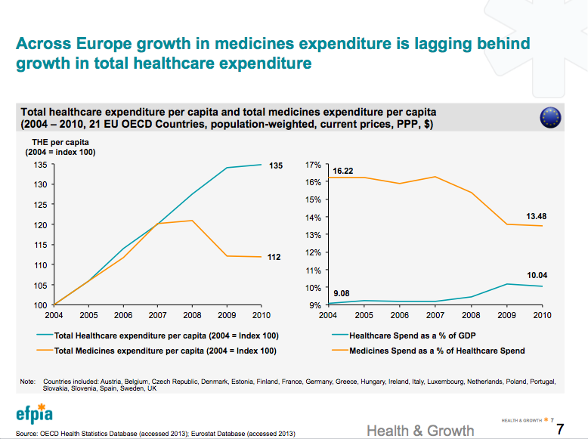
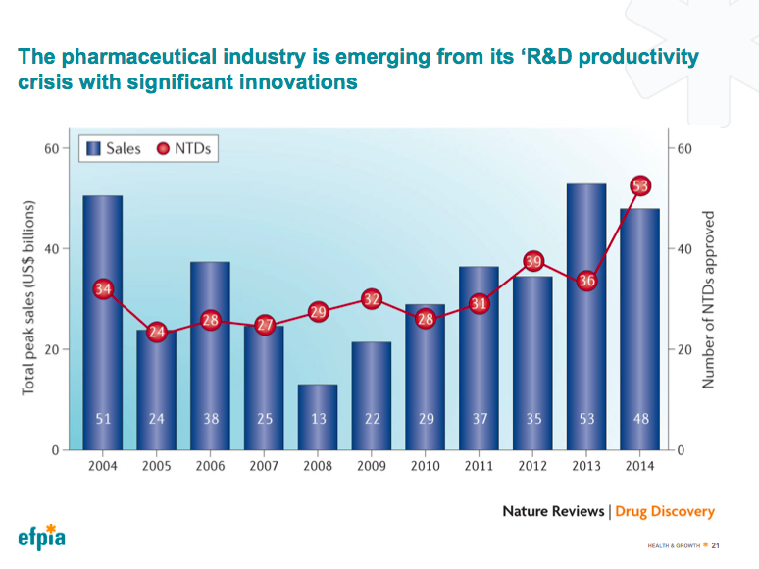
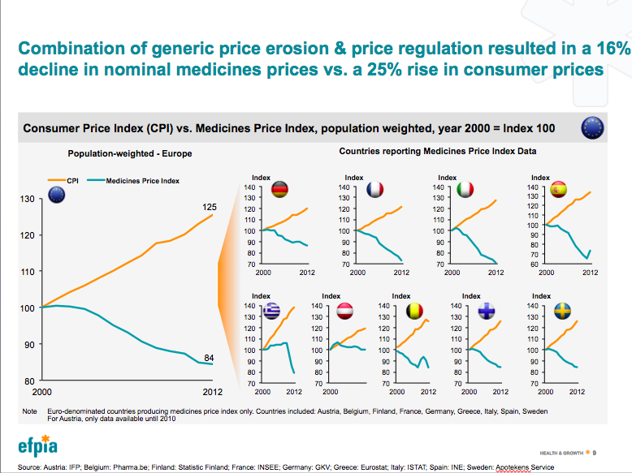
There is still a need to put the medicines bill in context – but the case needs to be made for growth of investment due to new innovations
Powerful story on declining share of HC Spending driven by LoE
Bur strong recent performance of high value – high budget impact products

Slide 16
Dealing with disruption – the need for a credible solution for the introduction of major high-value innovations
High
“The trouble with some new innovations is that even though they may be cost effective, the budget impact is so high that the system can’t cope” NICE (at a recent EU meeting on pricing and reimbursement)
Clear the way
New solutions needed!
Medium
Likely focus on managed entry agreements/ adaptive approaches
Planning budgeting and horizon scanning processes are variable around Europe
Often budget impact of major innovations is uncertain before launch (and in the early post launch period)
Lack of solution can lead to ‘payer panic’ and more aggressive pricing pressure since patients demand access?
How to smooth market entry?
Relative Value
Unlikely to get used!
Low
Low
Medium
High
Budget Impact

Slide 17
Key Success factors for Financial Sustainability
Ensure all health spending is as smart as possible and focused on health outcomes.
We need better horizon scanning and a more integrated approach to the allocation of resources – and end to silo thinking!
Medicines should reflect value for money and we need to improve systems for understanding and measuring value
Invest in the right information infrastructure to help decision makers
Common sense evaluation for all major investment or policy initiatives aimed at improving efficiency
Rational use of technology – including medicines. This involves investment in innovation, use of older products where appropriate – and disinvestment of technology that are no longer required
A more sophisticated approach to collaboration will enable better horizon scanning which can help access to innovation and budget management

Slide 18
EFPIA Brussels Office
Leopold Plaza Building
Rue du Trône 108
B-1050 Brussels - Belgium
Tel: +32 (0)2 626 25 55
www.efpia.eu
Notes:
Final Page

